Slide 1


SETI -
Search for Extra-terrestrial Intelligence -
Perspectives of an Earth Scientist
Donna M. Jurdy
Northwestern University
NASA/JPL
Notes:
1
<number>
<number>

Slide 2





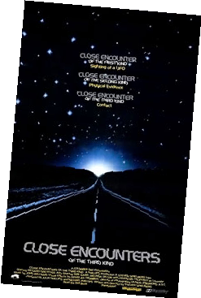

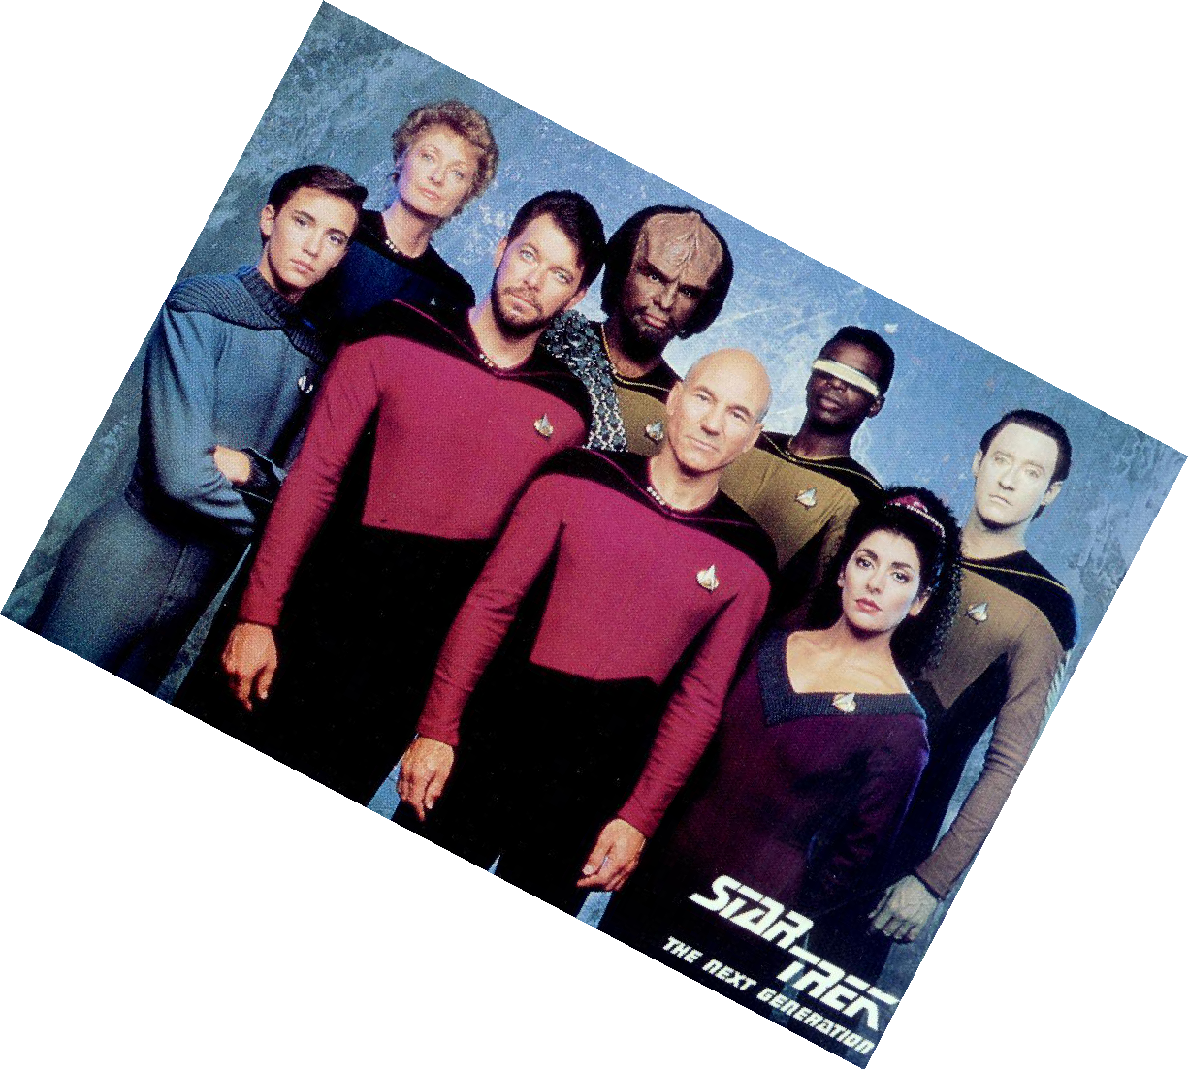


Notes:
1
<number>
<number>

Slide 3
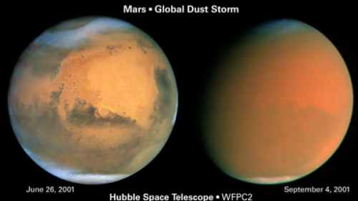
Notes:
1
<number>
<number>
Not vegetation!

Slide 4
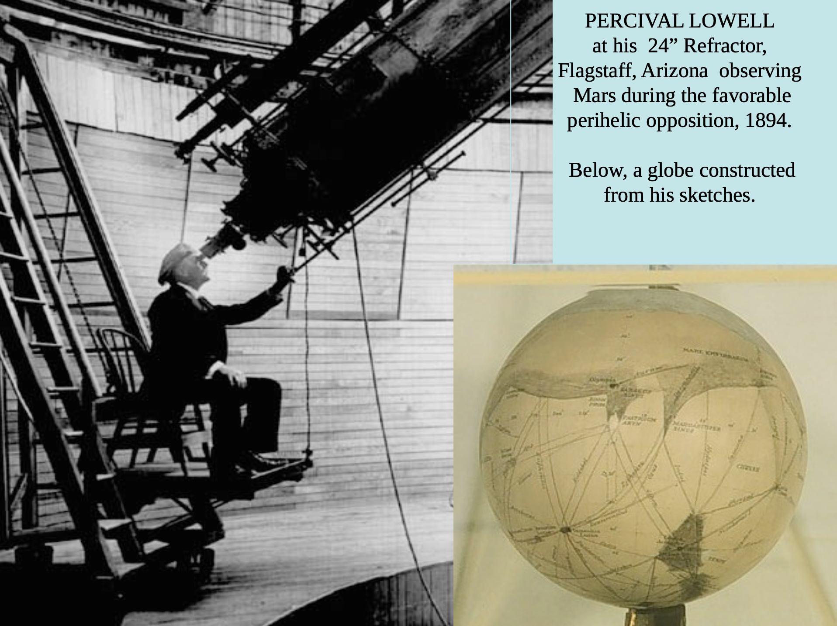
Notes:
1
<number>

Slide 5
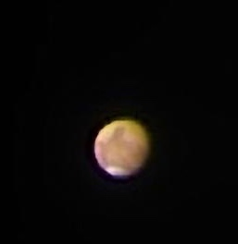
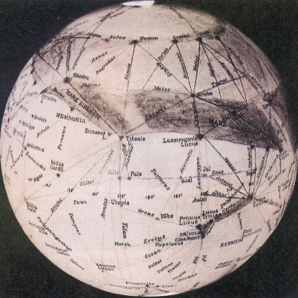
Notes:
1
<number>
<number>

Slide 6
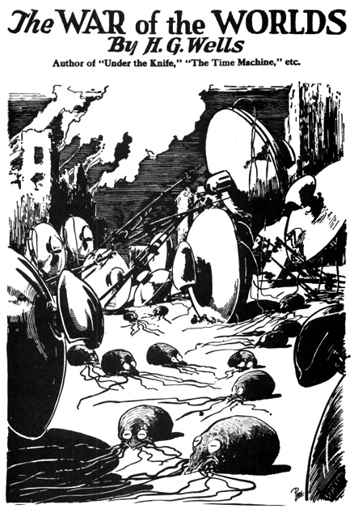
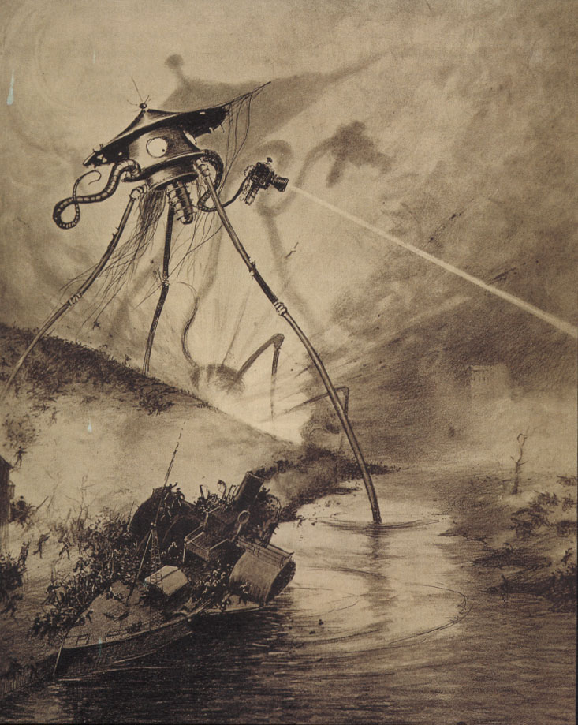
H.G. Wells
The War of the Worlds
(1898)
Notes:
1
<number>
<number>

Slide 7
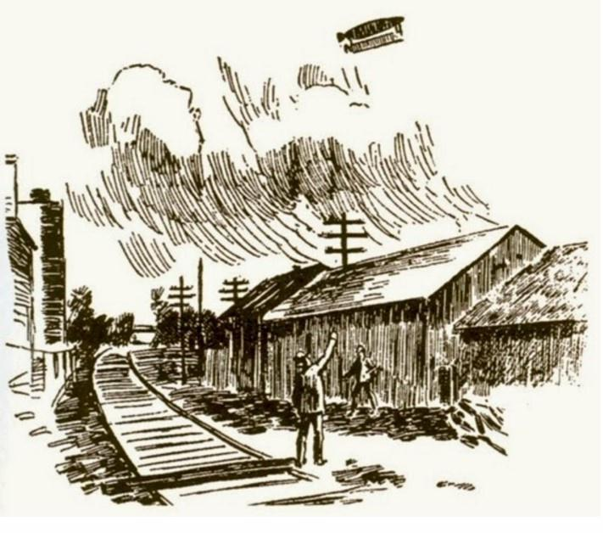
Notes:
1
<number>

Slide 8
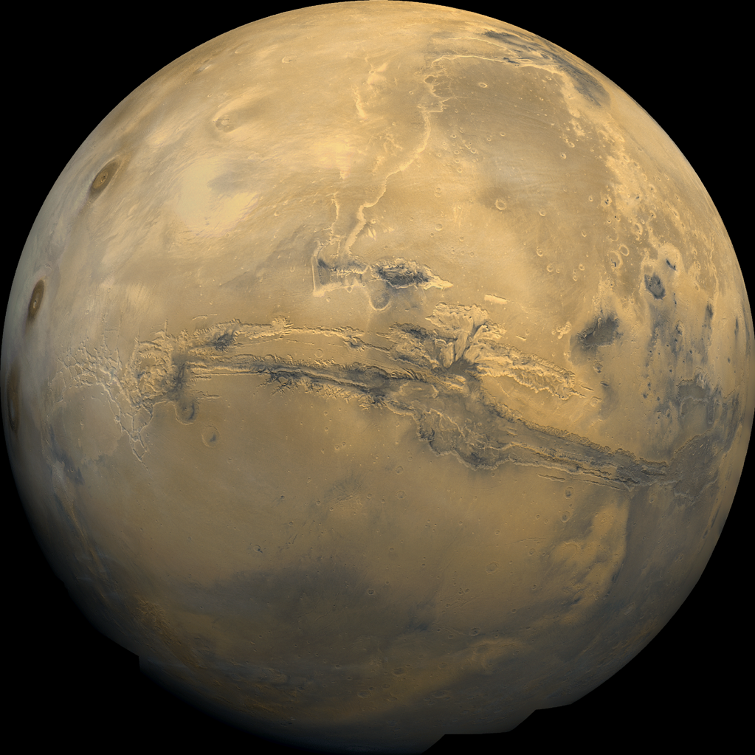
Viking composite of Mars
mid 1970’s
Notes:
1
<number>
<number>

Slide 9
Notes:
1
<number>
<number>

Slide 10
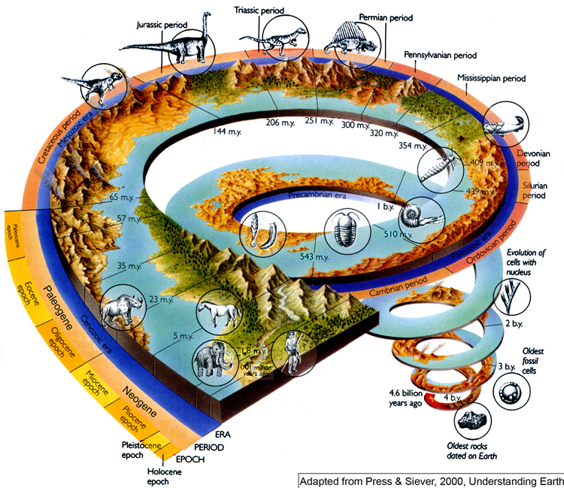
Notes:
1
<number>
<number>
History of Life on Earth:
Oldest meteorite fragments found on Earth ~ 4.54 billion years ago
Zircons found to form at 4.4 billion years ago
Earliest identified orgamisms were minute and relatively featureless, and their fossils looked like small rods
Oldest undisputed lifeform found in rocks at 3 billion years ago (prokaryotes), but others have found possible evidence of life up to 3.8 Ga.
3.4 Ga stromatolites (layered accretionary structures formed in shallow water by the trapping, binding, and cementation of sedimentary grains by biofilms of microorganisms, especially cyanobacteria).
2 Ga complex cells (eukaryotes)
1 Ga multicellular life
600 Ma simple animals
550 Ma complex animals
<number>

Slide 11
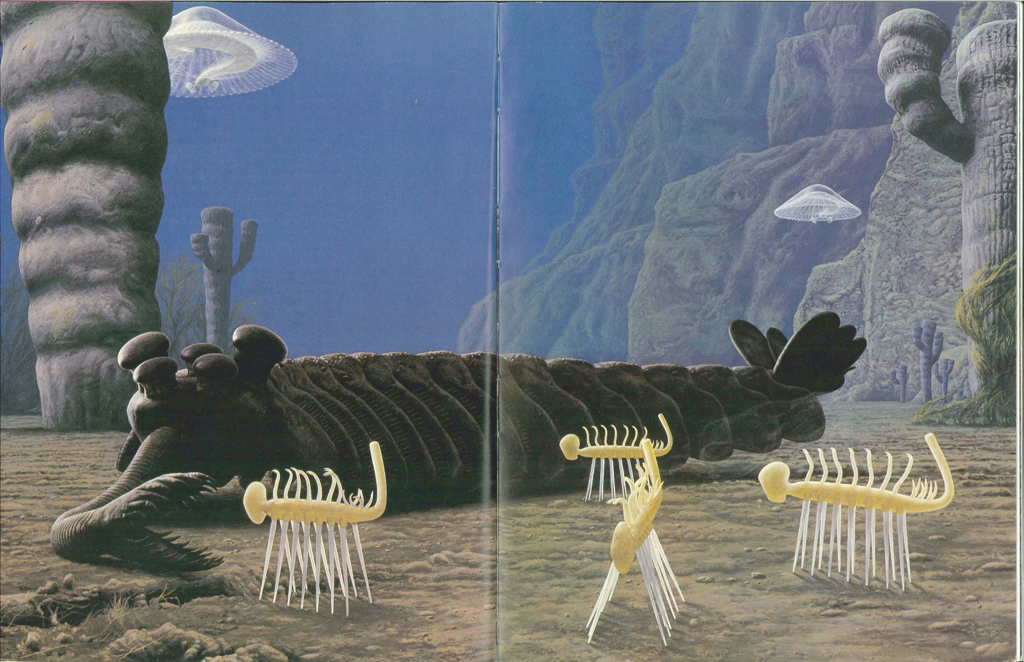
Notes:
1
<number>
<number>

Slide 12
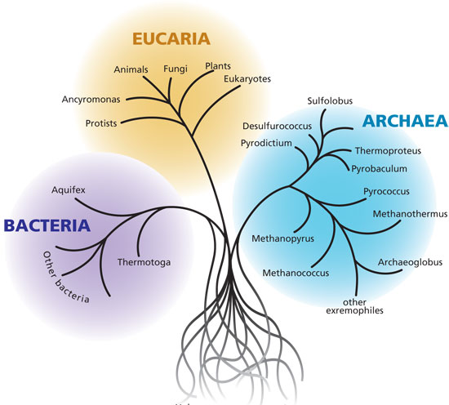
Image Credit: Woods Hole Oceanographic Institution
Notes:
1
<number>
<number>
<number>

Slide 13
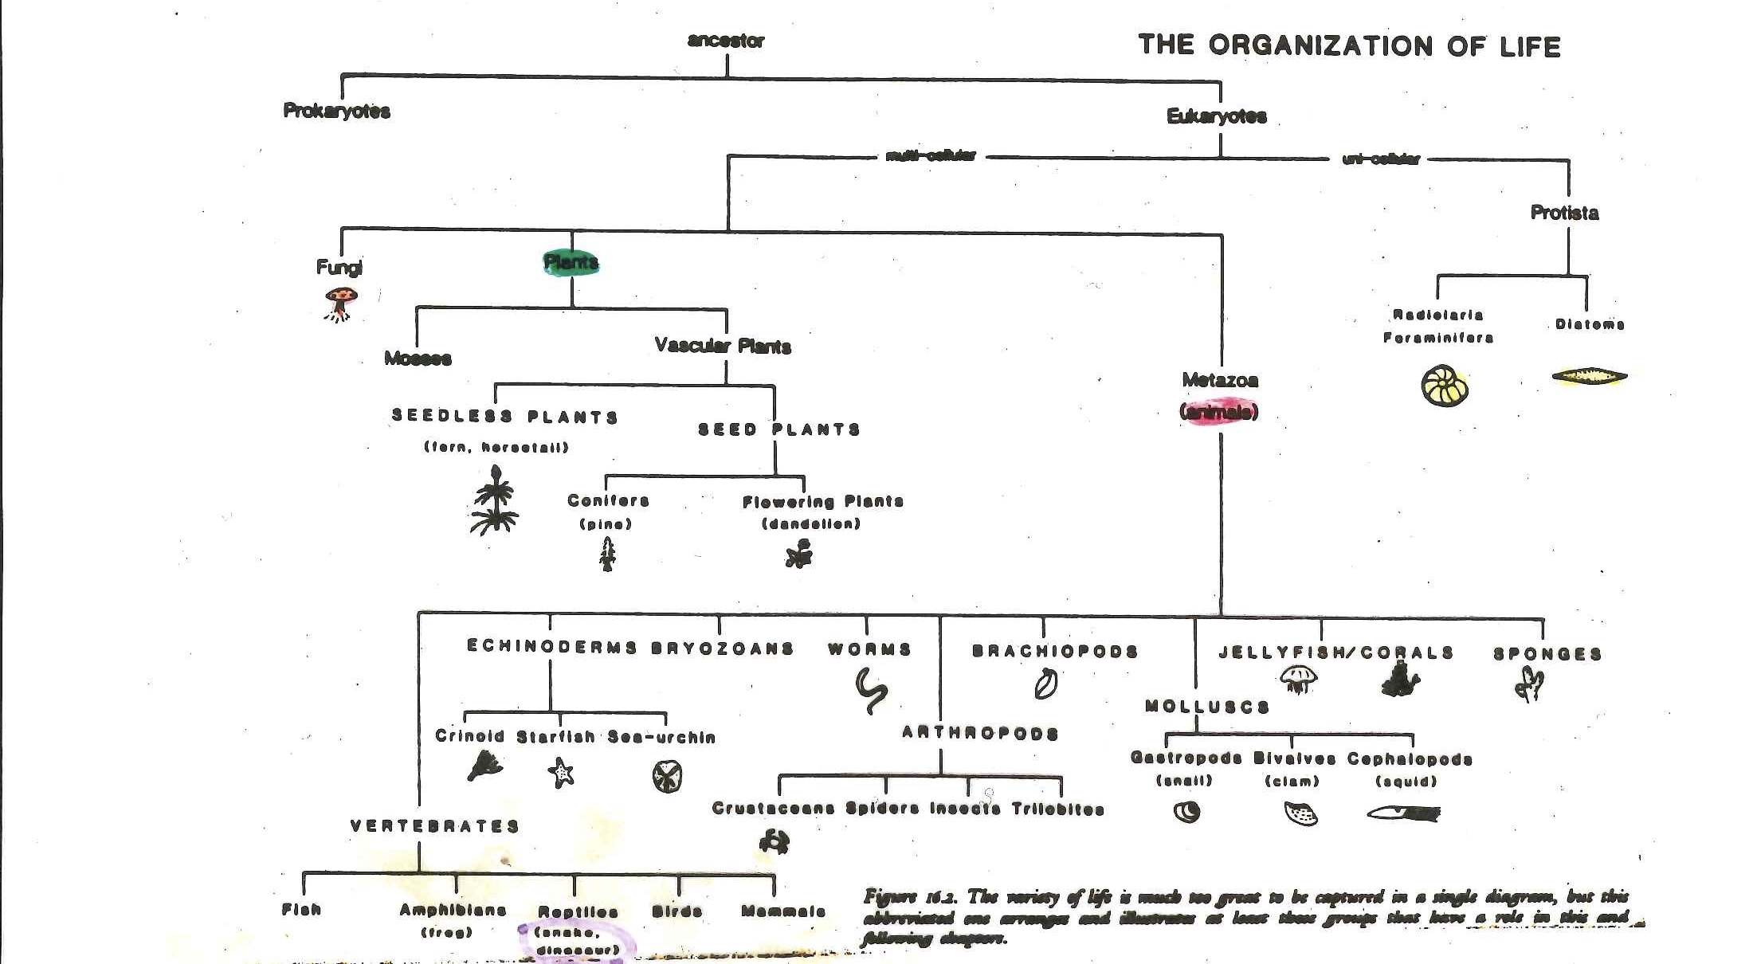
Vertebrates’ view of ‘Tree of Life’ c. 1960
© 2014 Pearson Education, Inc.
Notes:
1
<number>

Slide 14
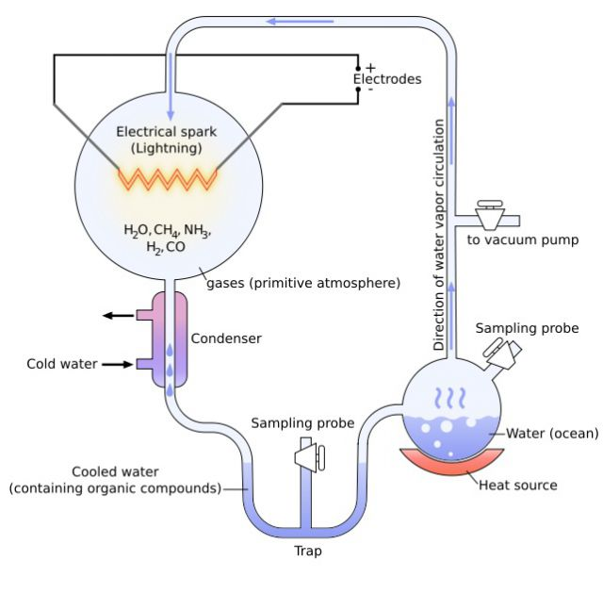


The Miller-Urey Experiment
Above: Harold C. Urey (1893-1981)
Left: Stanley L. Miller (1930-2007) with a reproduction of the experimental setup he first used in the 1950’s to study pathways to the origin of life.
Notes:
1
<number>
<number>

Slide 15

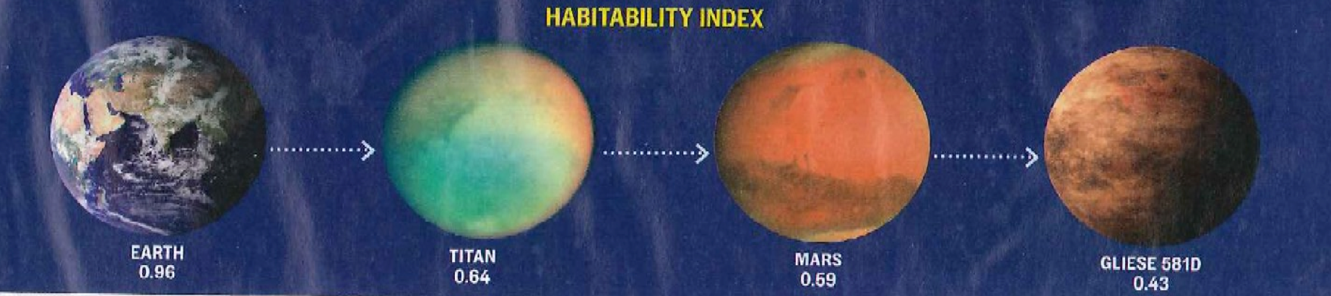
Needed for Habitability?
Solid surface
Atmosphere
Liquid on surface:
Need not be water
PHI – Planetary Habitability Index:
Schulze-Makuch et al., 2011
Notes:
1
<number>
<number>

Slide 16
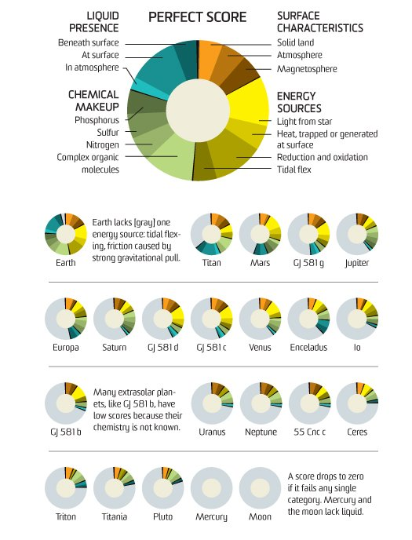
Habitability Index
Earth = 0.96
Titan = 0.64
Mars = 0.59
Gliese 581d = 0.43
Credit: Popular Science
Notes:
1
<number>
<number>
<number>

Slide 17
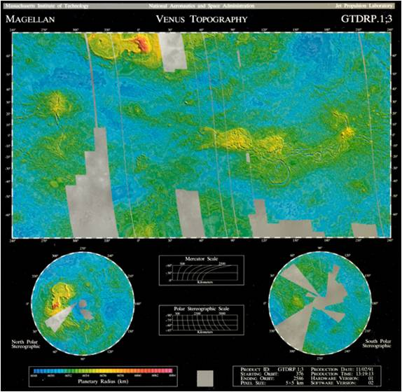
Notes:
1
<number>
<number>

Slide 18
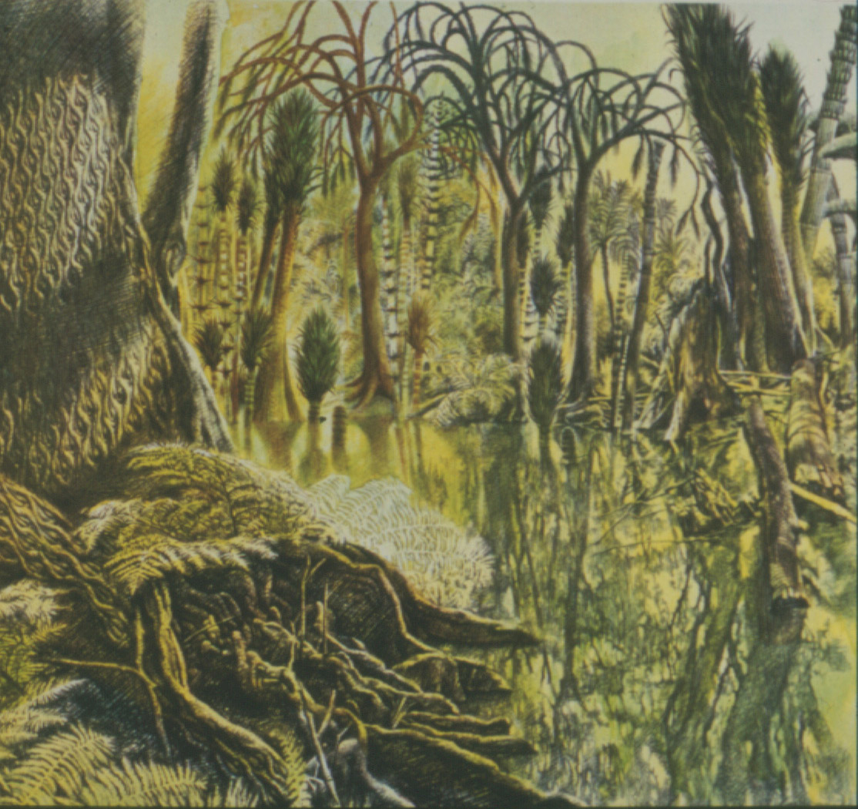
Early View of Venus
Notes:
1
<number>

Slide 19
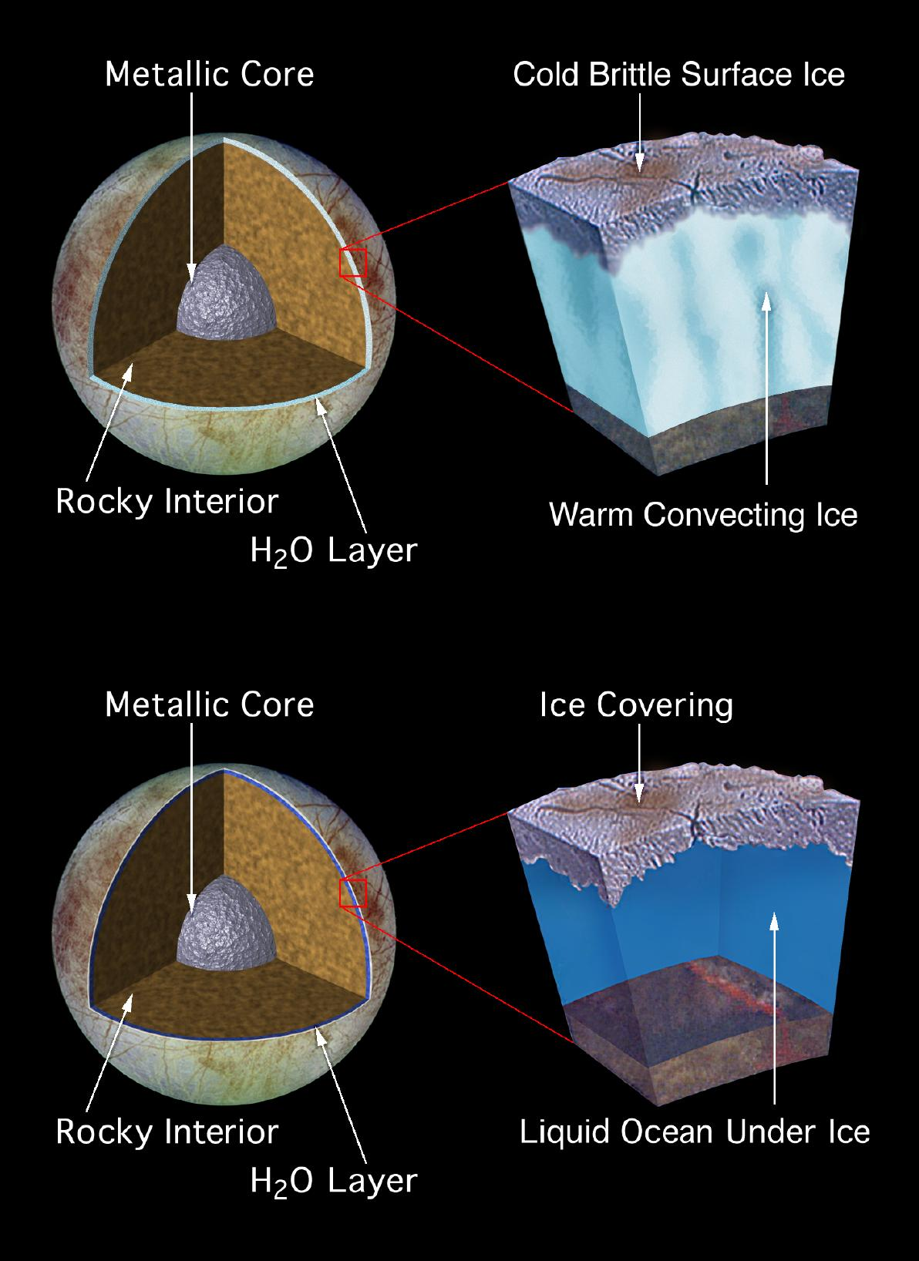
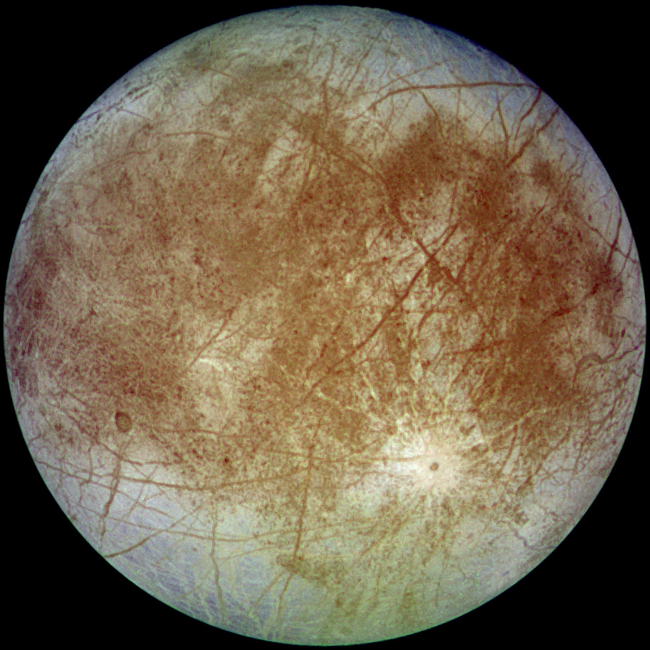
Europa
Notes:
1
<number>
<number>

Slide 20
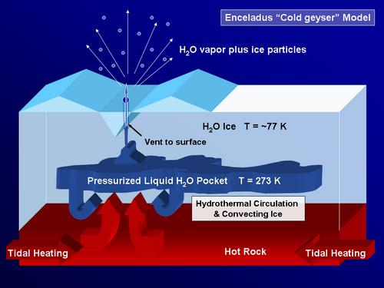
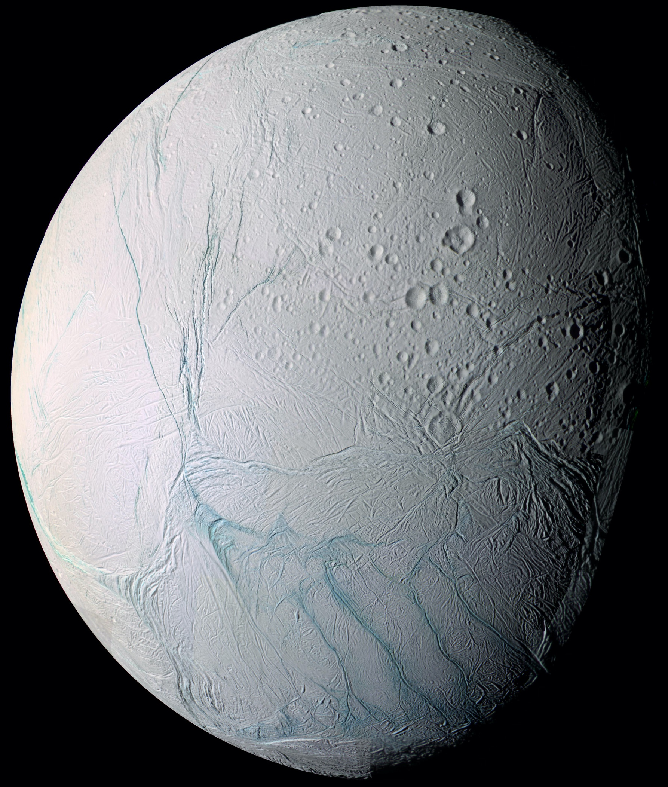
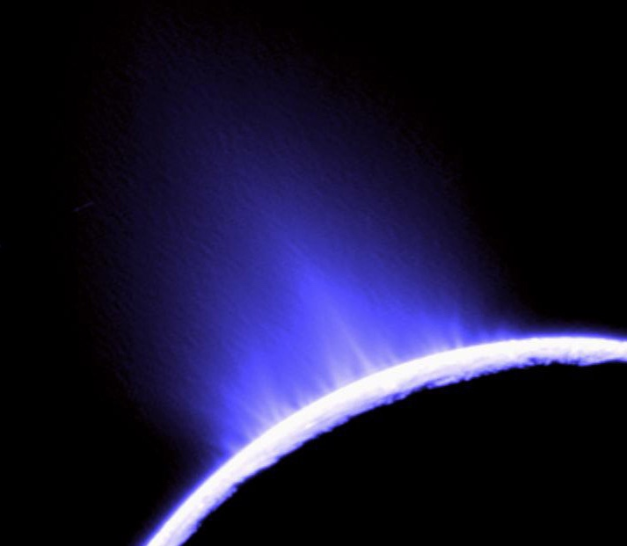
Enceladus
Notes:
1
<number>
<number>

Slide 21
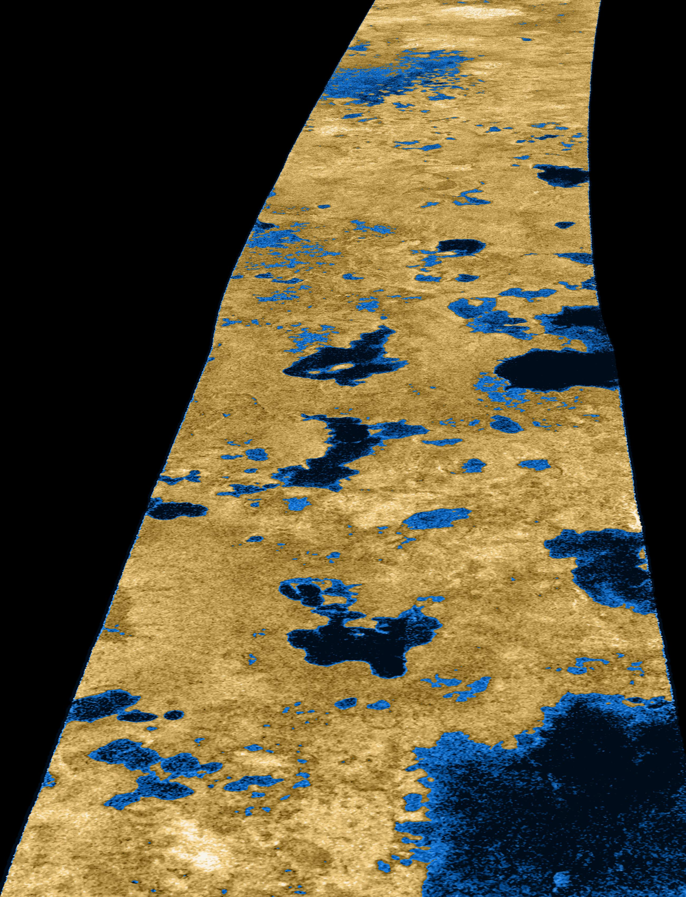
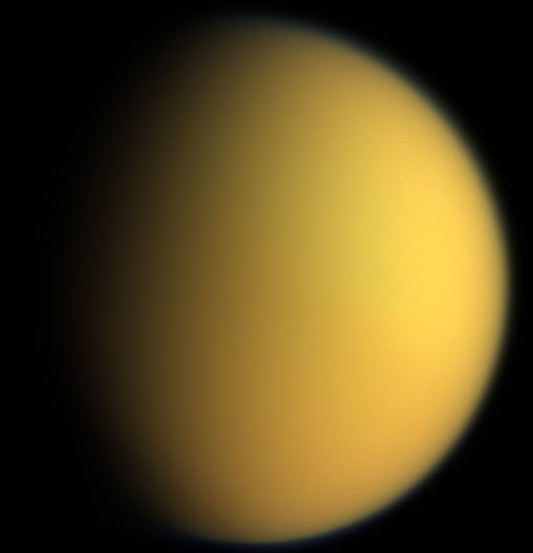
Titan
Notes:
1
<number>
<number>

Slide 22
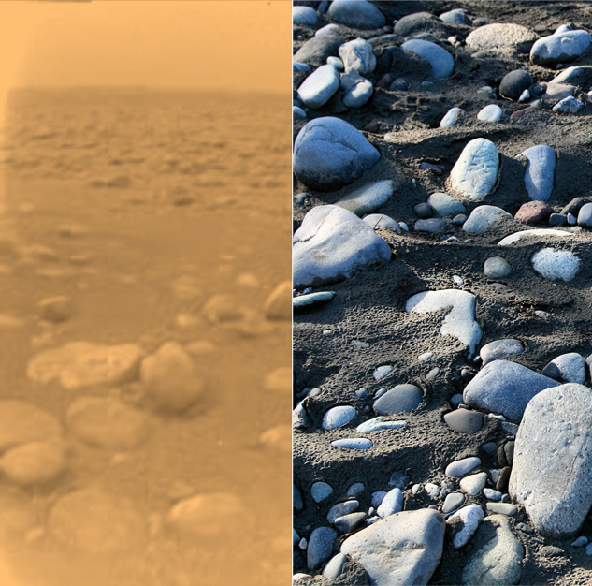
Huygens Landing Site
Landed January 14, 2005 at 10.2S, 192.4W
Discovered small “rocks”, possibly made of water ice, at the landing site.
Fluvial activity (methane?)
Images taken during descent showed no open areas of liquid, but indicated liquid had once flowed
Titan
Earth
Image Credit: NASA
Notes:
1
<number>
<number>
<number>

Slide 23

Notes:
1
<number>
<number>
<number>

Slide 24
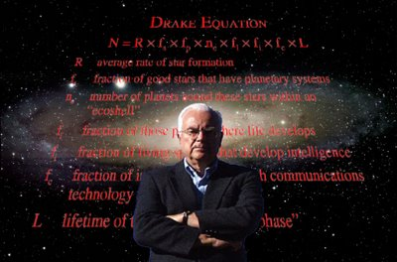

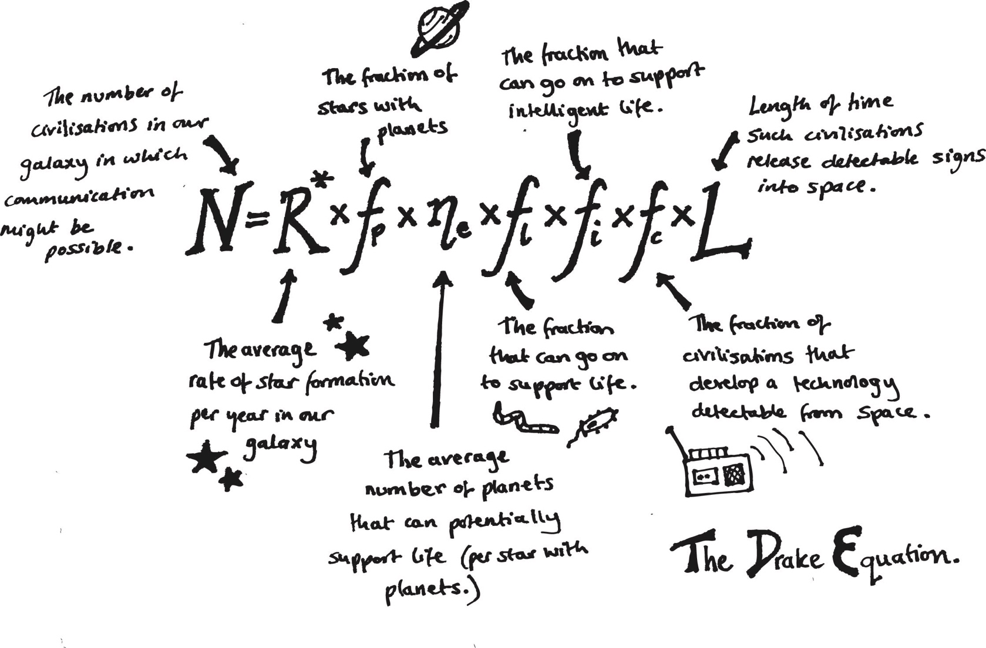

The Drake Equation
How many civilizations are out there?
Notes:
1
<number>
<number>

Slide 25
Notes:
1
<number>
<number>

Slide 26
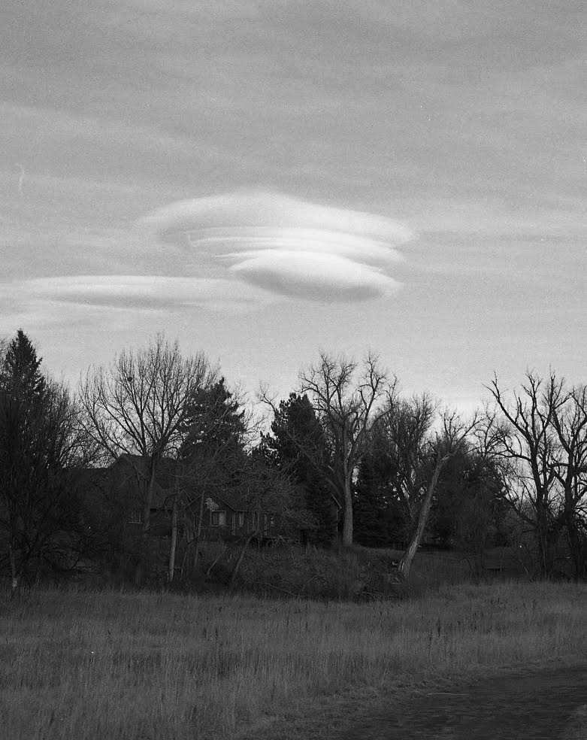
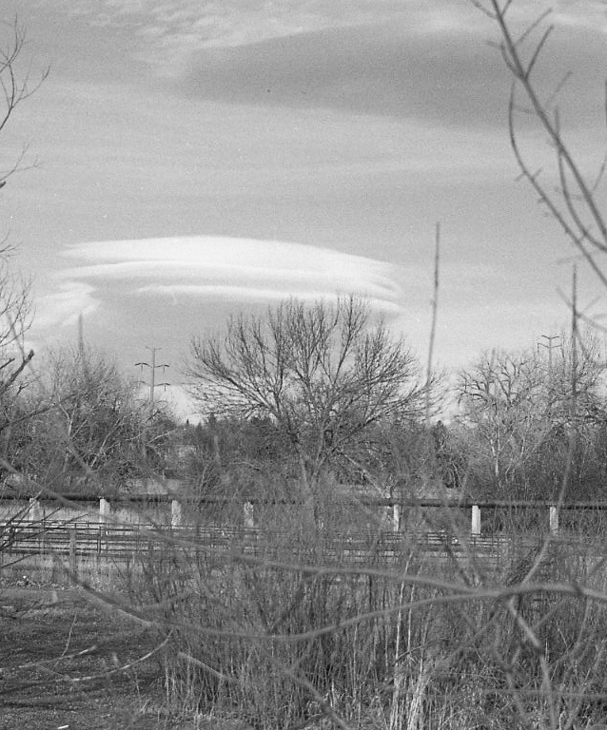
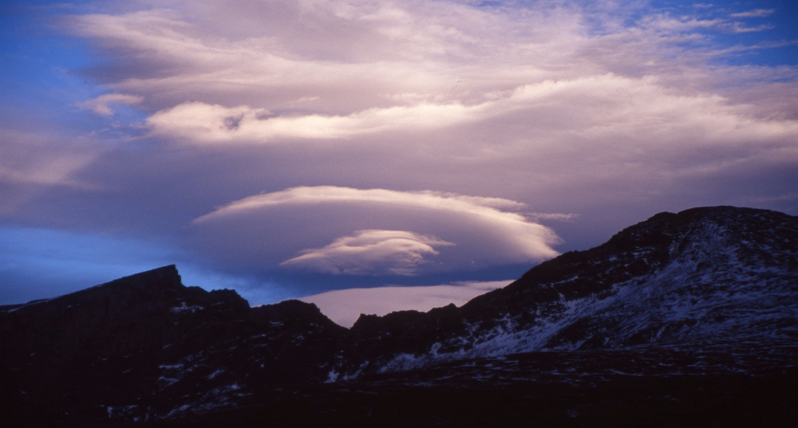
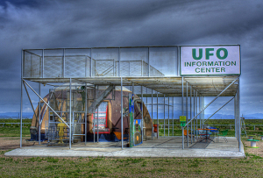
Notes:
1
<number>

Slide 27
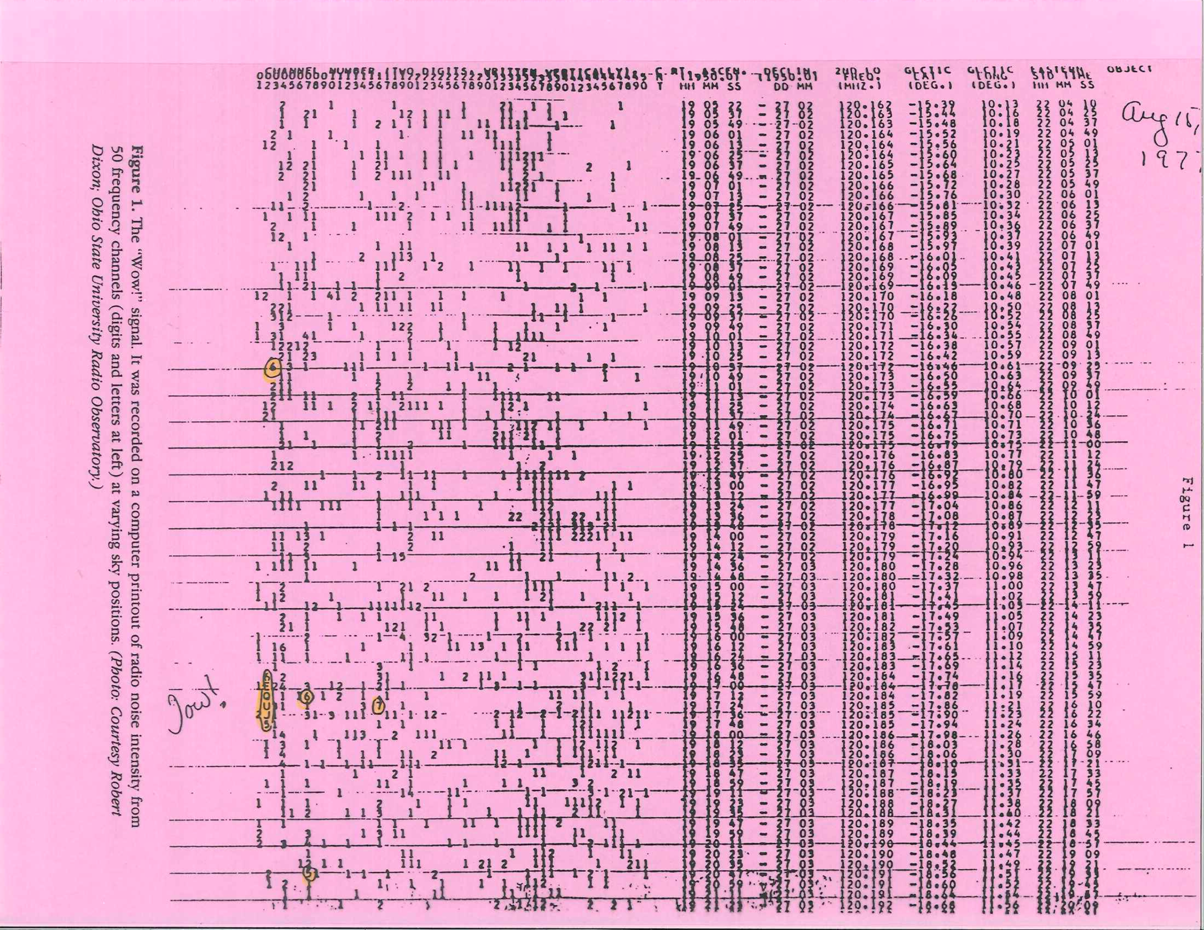
Notes:
1
<number>
<number>

Slide 28
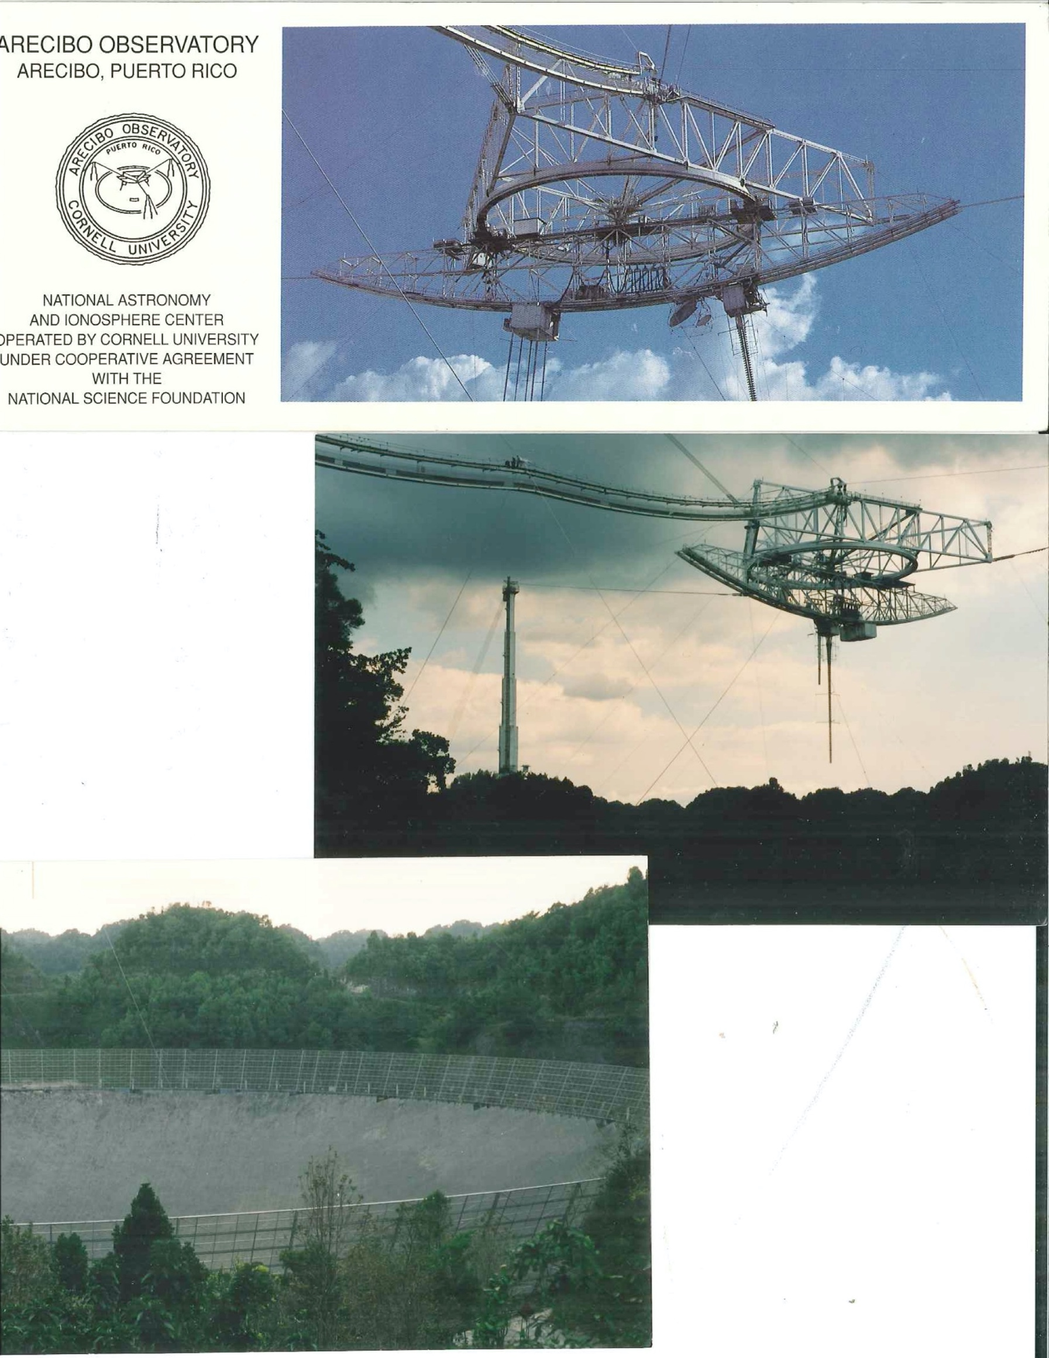
Notes:
1
<number>
<number>

Slide 29

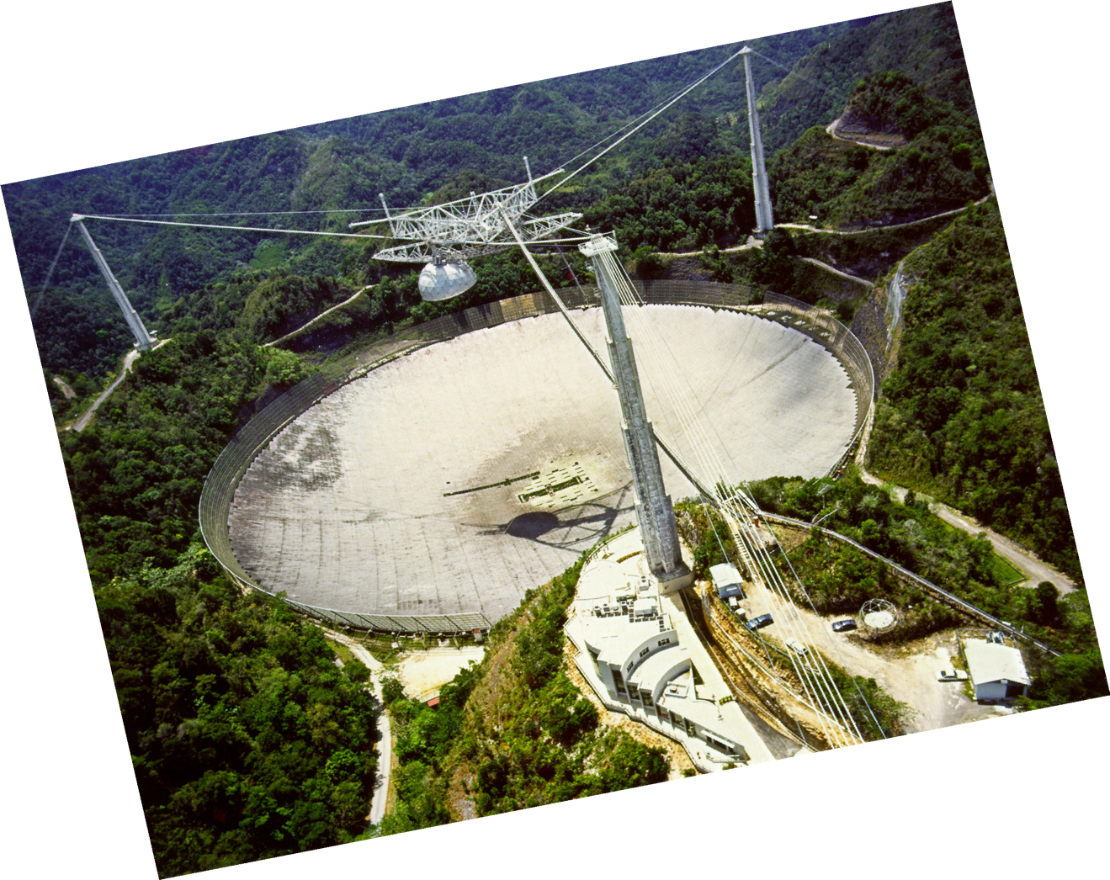
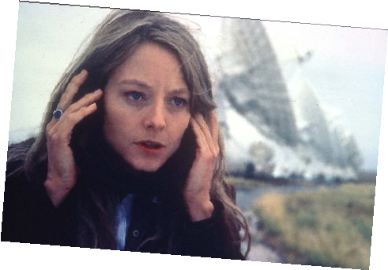
Notes:
1
<number>
<number>

Slide 30
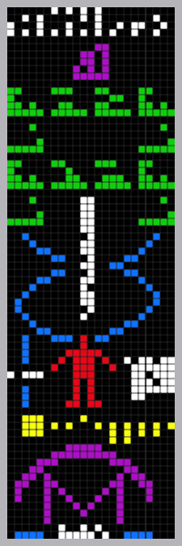
Arecibo Message
Broadcast on November 16th 1974 from the Arecibo radio telescope.
Aimed toward globular star cluster M13.
M13 is 25,000 light years away.
Notes:
1
<number>
<number>
Broadcast as part of a ceremony - remodeling of the telescope.
M13 was chosen because it was available in the sky during the ceremony.
The message takes 25,000 years to make it there because radio waves are EM waves.
Rich

Slide 31
ATA - Allen Telescope Array
NASA/JPL
Notes:
1
<number>
<number>

Slide 32

Notes:
1
<number>

Slide 33
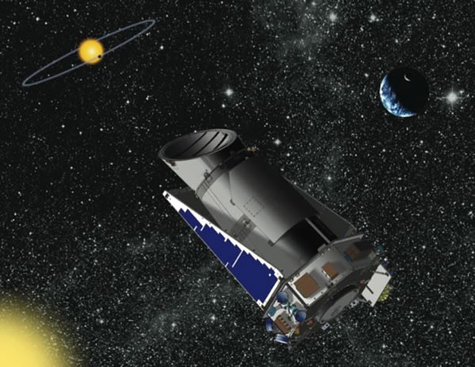
Kepler
Notes:
1
<number>
<number>
<number>

Slide 34
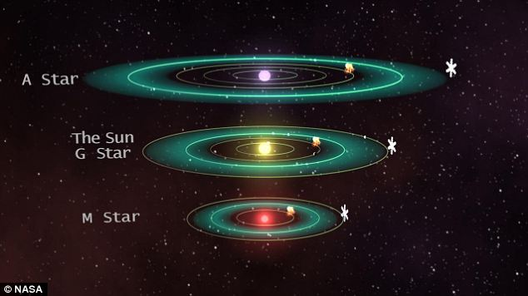
Life Around Other Stars
Notes:
1
<number>
<number>

Slide 35
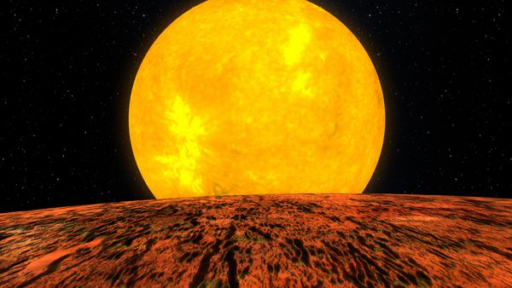
Imagined View from Planet Kepler-10b (Artist's Depiction)
Credit: NASA/Kepler Mission/Dana Berry
Notes:
<number>
<number>
<number>

Slide 36
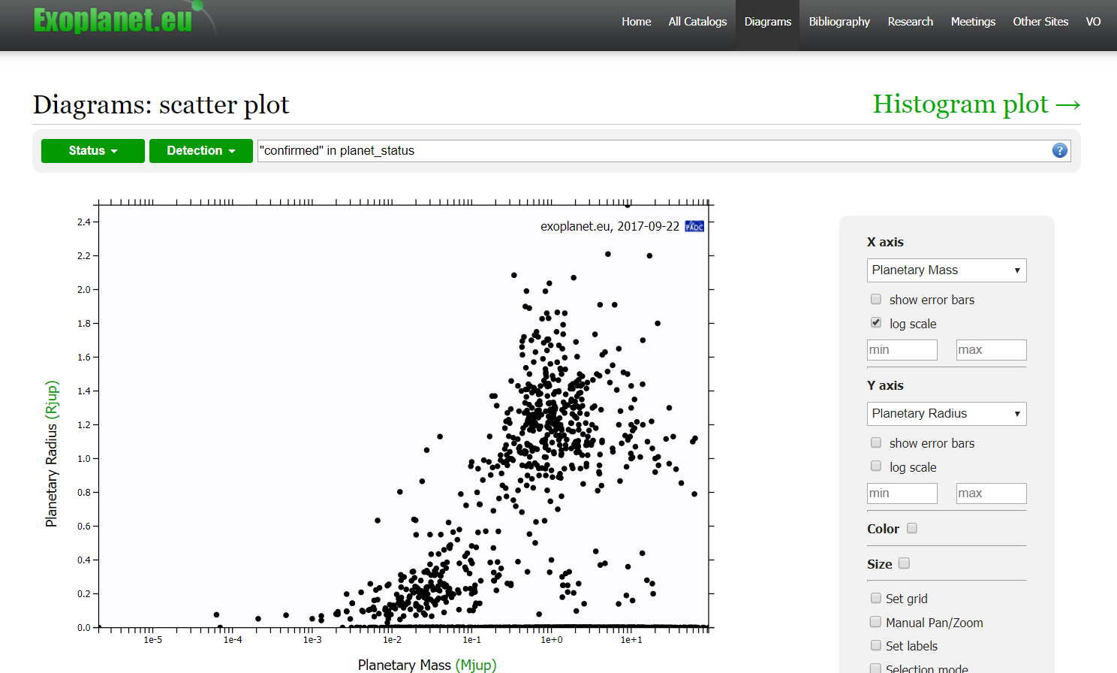
Brown Dwarfs
Jupiter
Earth
Notes:
<number>
<number>

Slide 37

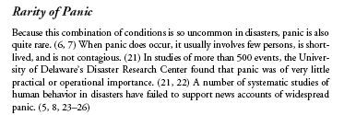

Notes:
<number>
<number>
<number>

Slide 38

Notes:
<number>
<number>
<number>

Slide 39
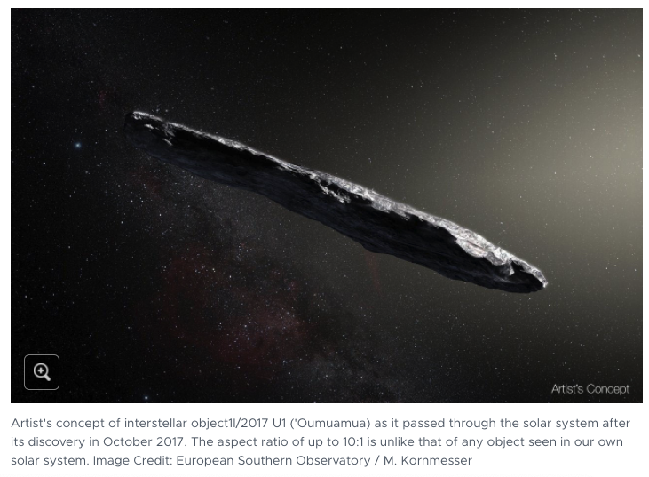
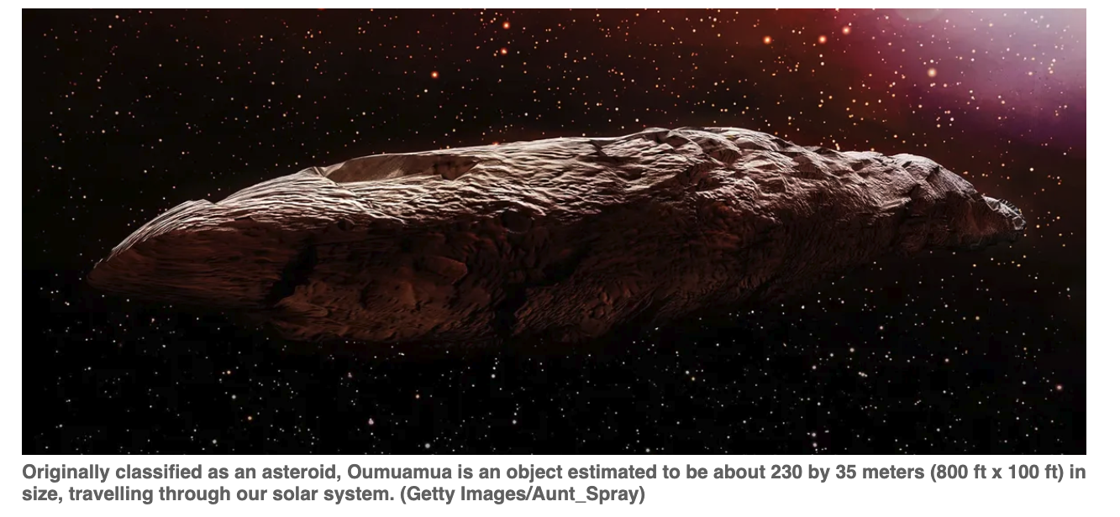
Notes:
<number>

Slide 40
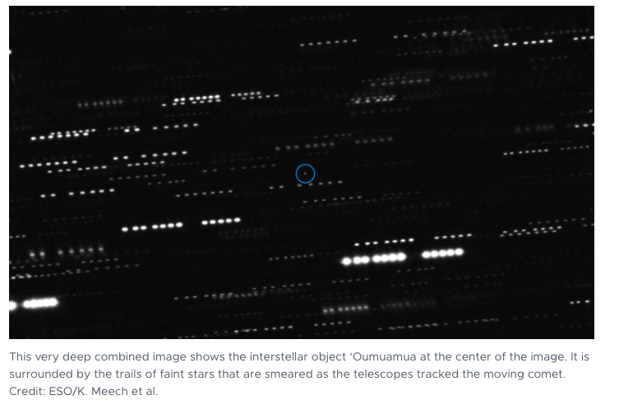
Notes:
<number>

