Slide 1
Maulin Hemani, Sam Remler, Wyatt Cook

Slide 2
What is Whipple?
Whipple will reach much deeper into the unexplored frontier of our outer solar system than any other mission, current or proposed
Theory says that the the Oort Cloud extends 20,000AU’s beyond the sun
Whipple is an opportunity to extend our observational horizon by almost double!
Notes:
Source: https://www.cfa.harvard.edu/news/2011-13

Slide 3
What is Whipple? (cont)
With very limited light, objects are difficult to detect directly against the blackness of space
These objects hold clues to the evolution of our Solar System
Using Blind Occultation, Whipple will monitor tens of thousands of stars trying to spot their shadows.
Notes:
Source: https://www.cfa.harvard.edu/news/2011-13

Slide 4
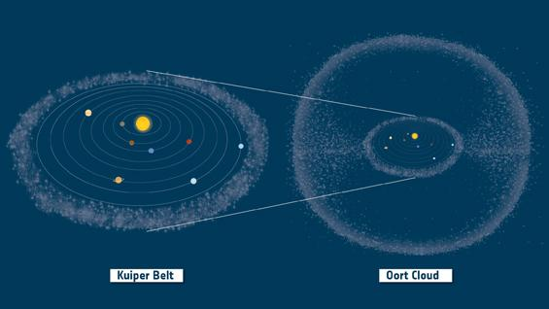
Background
Notes:
Image Source: http://www.esa.int/var/esa/storage/images/esa_multimedia/images/2014/12/kuiper_belt_and_oort_cloud_in_context/15106869-1-eng-GB/Kuiper_Belt_and_Oort_Cloud_in_context.jpg

Slide 5
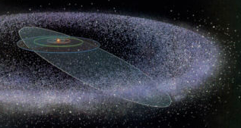
Kuiper Belt
The Kuiper Belt is an elliptical plane in space spanning from 30-50AU
It is similar to the asteroid belt between Mars and Jupiter but it is believed to be more icy than rocky
Thousands of bodies with diameters of 100 km+ and trillions of bodies total
The Kuiper belt contains the remnants from the beginning of the solar system and can provide valuable insights into the formation of the solar system
Pluto, Eris and other dwarf planets are Kuiper Belt Object (KBO)

Slide 6
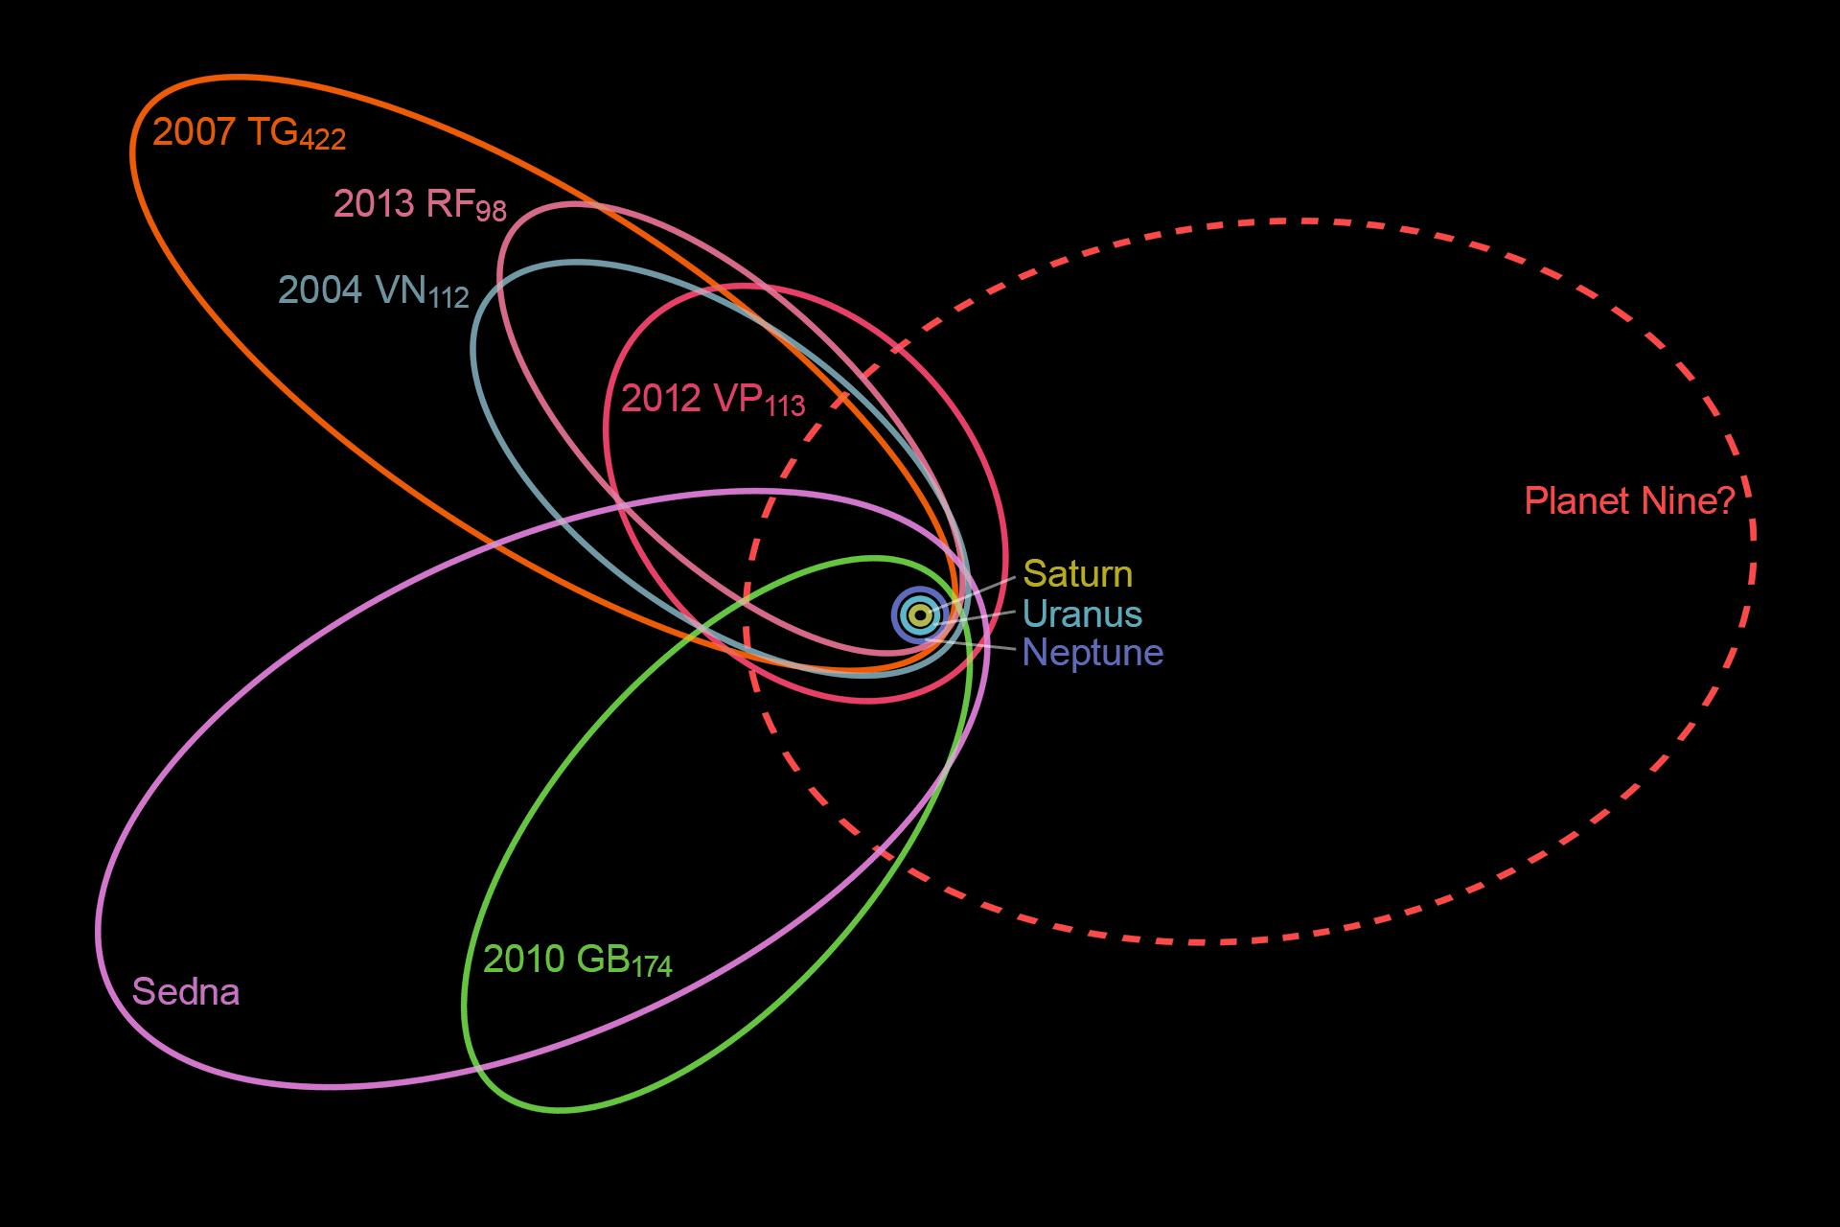
Planet 9
Believed to orbit the sun at 600 times farther than the orbit of the earth
Planet has never been seen directly but has been inferred from gravitational effects of other KBO’s
Believed to be close to Earth’s size but 10 times earth’s mass

Slide 7
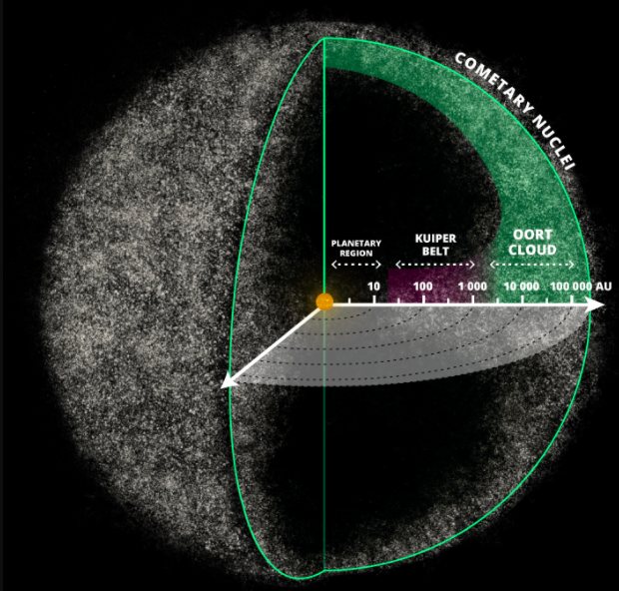
Oort Cloud
Believed to be an icy debris that surrounds our solar system
Could extend up to ⅓ of the way from our star to the next
At this point, the Oort Cloud is all theory
Population estimates suggest that the outer cloud is ∼ 1012 comets with nuclei >2 km in diameter
This leads to an estimate of >7 M⊕ for the total mass of comets in the Oort Cloud

Slide 8
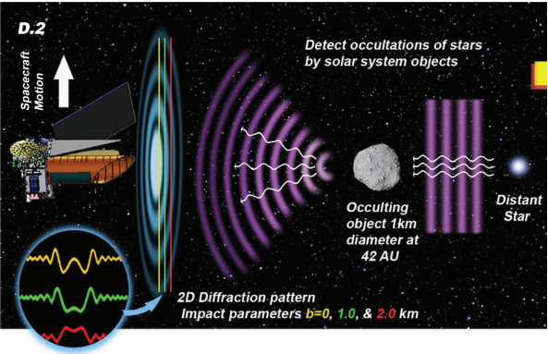
Blind Occultation Technique
Notes:
Image Source: Laboratory prototype camera for the Whipple Mission: a mission to detect and categorize small objects in our solar system (Kenter)

Slide 9
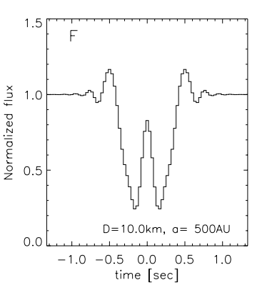
Occultation Technique
Measuring star intensity
7 sample running average
256 sample running average
If noticeable difference then evaluate numbers manually; can determine star locations in Oort cloud.
Diameter of object determined by the amplitude, and the duration of this change in flux shows how far the object is away.

Slide 10
See more stars
The telescope will have three frequency modes: 5 Hz, 10 Hz, and 40 Hz
80,000 stars at 5 Hz
40,000 stars at 10 Hz
10,000 stars at 40 Hz
Different stars detectable at different frequencies

Slide 11
Other Applications of this Technology
Improve telescope technology we are using on Earth and on Hubble
Taiwanese Astronomical Occultation Survey
See more going on in the outer solar system, from Earth
Help us become less reliant on light for our looks into the solar system
Potentially will make way into mainstream cameras for better focal depth in typical pictures.
Notes:
Source: https://www.researchgate.net/publication/228842923_Whipple_Exploring_the_Solar_System_Beyond_Neptune_Using_a_Survey_for_Occultations_of_Bright_Stars

Slide 12
Key Components of Whipple
The Whipple Spacecraft will include:
The Telescope
Very large camera + imagers
Telecom Components
Too early in the process for concrete plans of the spacecraft
Notes:
Source: https://www.researchgate.net/publication/228842923_Whipple_Exploring_the_Solar_System_Beyond_Neptune_Using_a_Survey_for_Occultations_of_Bright_Stars

Slide 13
Learnings from Whipple
We have never explored this far out into the solar system before!
We can learn about these far away bodies and map their presence in space
We can start seeing what is currently “invisible” to us and our current technology
Notes:
Sources: https://www.spiedigitallibrary.org/conference-proceedings-of-spie/8146/814612/Laboratory-prototype-camera-for-the-Whipple-Mission--a-mission/10.1117/12.894626.full

Slide 14
Learnings from Whipple (cont)
Specifically, we will see and learn about a large quantity of new bodies in space
By observing the Oort Cloud, we can definitively prove its existence.
Evolution of Solar System ->
Notes:
Sources: https://www.spiedigitallibrary.org/conference-proceedings-of-spie/8146/814612/Laboratory-prototype-camera-for-the-Whipple-Mission--a-mission/10.1117/12.894626.full

Slide 15
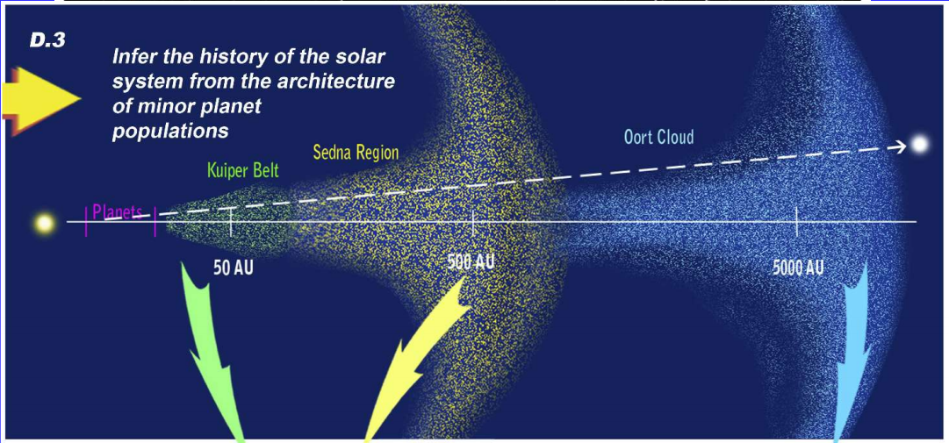
Learn about evolution of Solar System

Slide 16
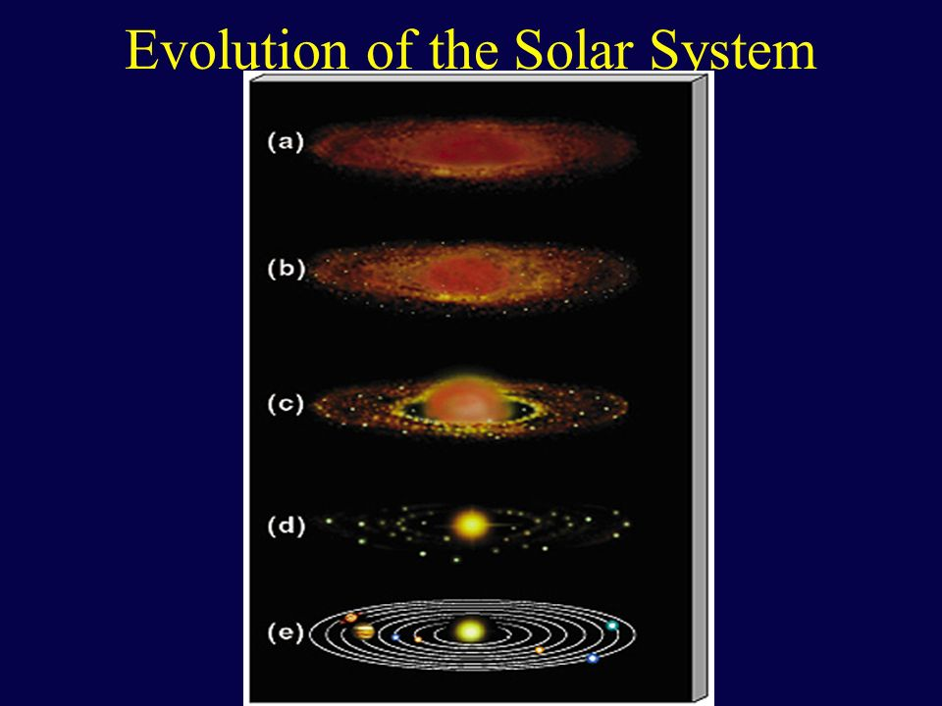
Evolutionary Models
Building off the last slide, the insights and data that we can garner from observations from Whipple can be used to improve as well as develop new formation and evolutionary models of the Solar System
With more accuracy, these models can better inform us about how Solar Systems form
Notes:
Source: http://slideplayer.com/slide/768360/2/images/9/Evolution+of+the+Solar+System.jpg

Slide 17
Impacts on Earth
Doesn’t necessarily inform us about sustainability on Earth
However, it certainly benefits humanity overall:
Innovative new technology
Never before seen pictures (front page headlines!)
Better understanding of the far outer Solar System and how our Solar System formed

Slide 18
Risks
Technology needs to become fully robust -- Harvard continues to test it in its labs to refine
Full Costs haven’t been determined yet

Slide 19
Next Steps
More Funding!
Spacecraft plans need to be designed and developed
Determine possible Extension missions

Slide 20
Conclusion
The Whipple mission will teach us about an entirely new and vast part of our Solar System, currently unexplored
It will use exciting new technology
It’s a low risk, high reward mission

