Slide 1
Titan Atmospheric Chemistry
Yang Xia (Carl)

Slide 2
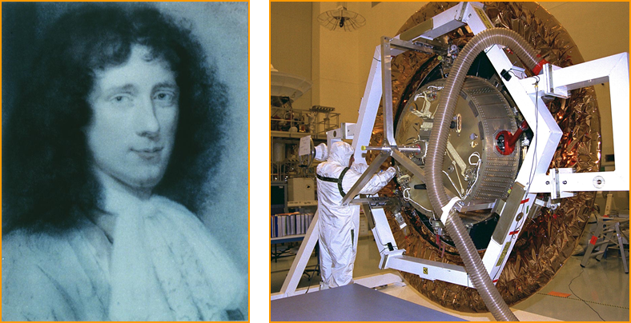
Titan was discovered in 1655 by Christiaan Huygens, a Dutchman

Slide 3
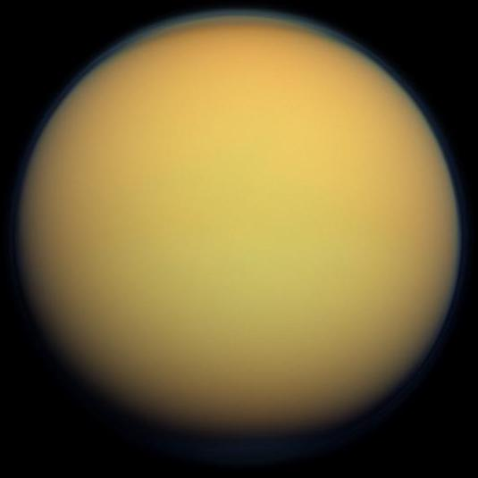
Titan Overview
2nd largest satellite in solar system (2575 km in radius)
Orbits Saturn at about 21 Saturn radii
Rotation is tidally locked to Saturn: period--16 earth days
Thick atmosphere with a surface pressure of 1.5 bar

Slide 4
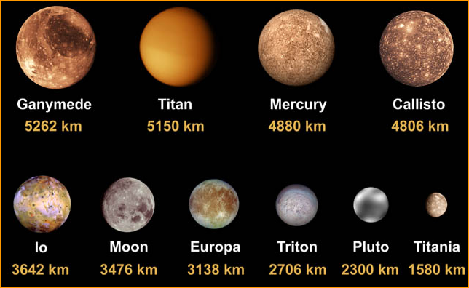
Diameter for different satellites in solar system

Slide 5
•Gerard Kuiper discovered that Titan had an atmosphere in 1944 by taking spectra of Titan
CH4 adsorption bands

Slide 6
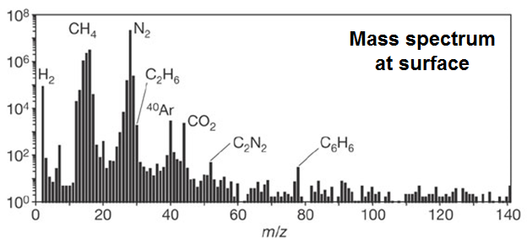
Huygens found evidence for C₂H₆, CO₂, C₂N₂, C₆H₆, and liquid methane at the surface
Cassini found evidence for water ice, C₆H₆, and “organics” at the surface
http://www.hems-workshop.org/5thWS/Talks/Thursday/Harpold.pdf

Slide 7
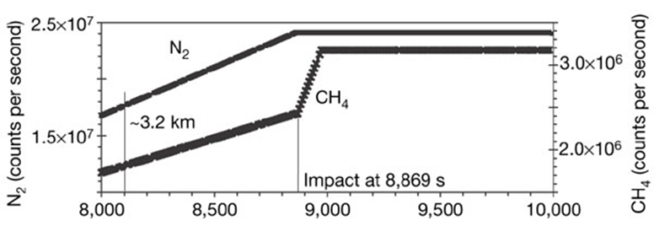
Spike indicates the presence of liquid methane at the surface.

Slide 8
Main Atmospheric Constituents
N2 (90~97%)
Methane (2~5%)
Argon (0~6%)
Assorted hydrocarbons & nitriles (C2H2, C2H6, HCN, …)
H2O (8 ppb), CO2 (10 ppb)

Slide 9
Consideration of Life: Nitrogen Fixation
N is an essential component in amino acids and nucleic acids
However, N2 cannot be directly used by most organisms due to their triple bonds (almost inert)
So it must be ‘fixed’ (or combined into) as NH4 (ammonium) or NO3 (nitrate) ions for living organisms to use

Slide 10
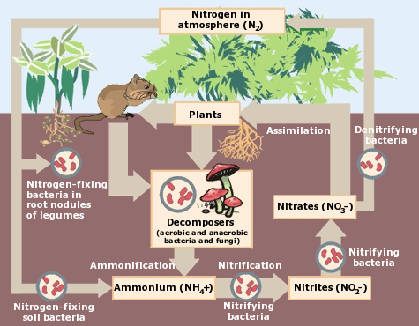
Nitrogen Fixation
On Earth:
Nitrogen-fixing bacteria
Lightning (N2+O2-->NO-->HNO3 (rain))

Slide 11
So, how does nitrogen fixation potentially happen on Titan?

Slide 12
On Titan:
Abundant N2 gas
Nitrogen organic aerosols (which form the haze layer completely covers the moon) are confirmed
An ionosphere discovered by Cassini-Huygens Mission

Slide 13
Atomic N production on Titan
N2 dissociation induced by:
Electron impact
Extreme UV photolysis
Dissociative photoionization
Cosmic ray
N2+ dissociative recombination
Types of atomic nitrogen:
N(⁴S)
N(²D)

Slide 14
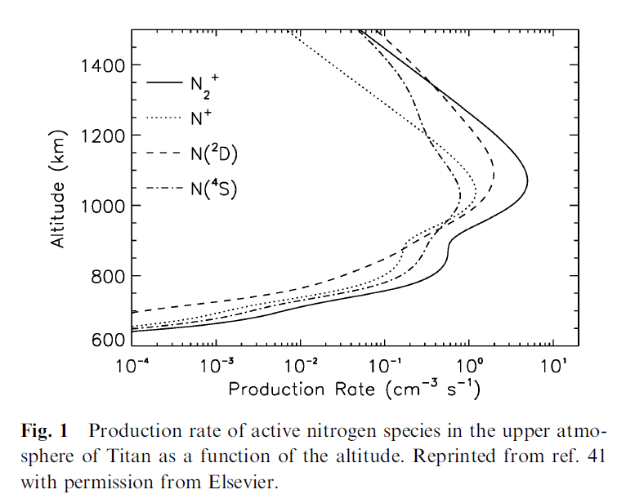
Balucani, Nadia. “Elementary Reactions of N Atoms with Hydrocarbons: First Steps towards the Formation of Prebiotic N-Containing Molecules in Planetary Atmospheres.” Chemical Society Reviews, vol. 41, no. 16, 2012, p. 5473., doi:10.1039/c2cs35113g.

Slide 15
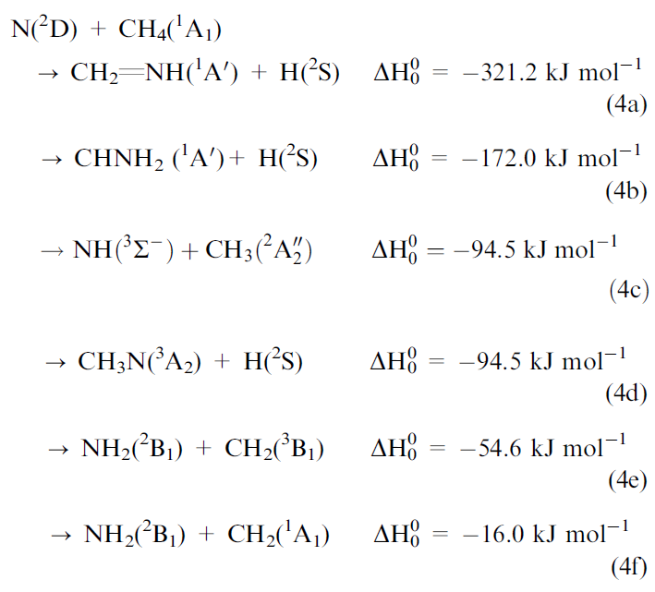
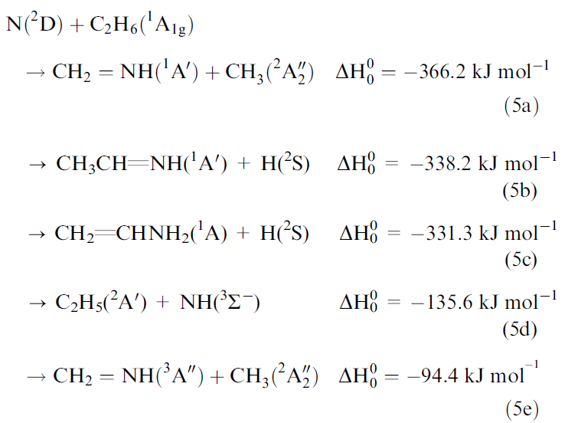
N. Balucani, F. Leonori, R. Petrucci, M. Stazi, D. Skouteris,
M. Rosi and P. Casavecchia, Faraday Discuss., 2010, 147, 189.
P. Casavecchia, N. Balucani, L. Cartechini, G. Capozza,
A. Bergeat and G. G. Volpi, Faraday Discuss., 2001, 119, 27.

Slide 16
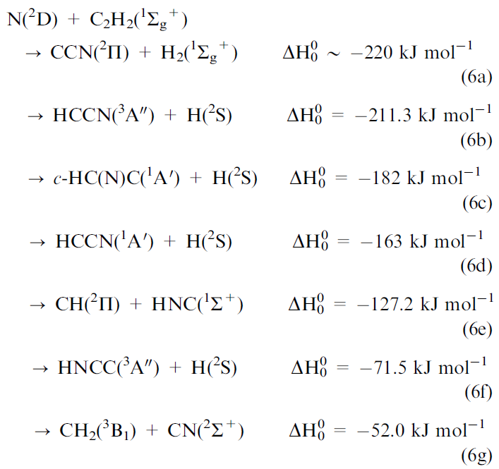
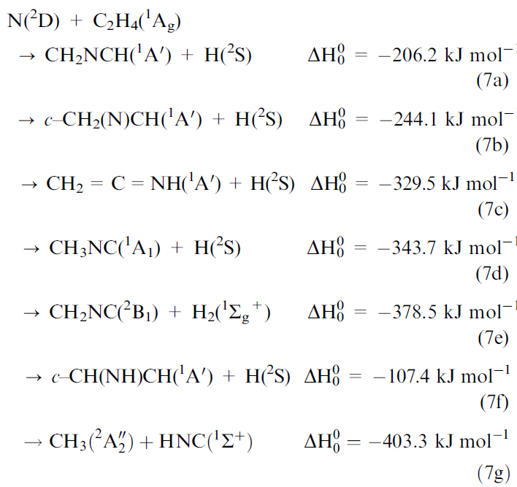
M. Rosi, S. Falcinelli1, N. Balucani, P. Casavecchia, F. Leonori
and D. Skouteris, Lecture Notes in Computer Science, 2012,
7333, 331
N. Balucani, M. Alagia, L. Cartechini, P. Casavecchia,
G. G. Volpi, K. Sato, T. Takayanagi and Y. Kurosaki, J. Am.
Chem. Soc., 2000, 122, 4443.

Slide 17
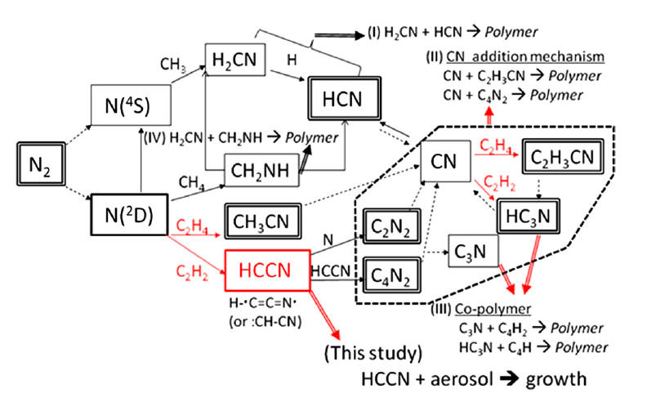
Imanaka, Hiroshi, and Mark A. Smith. “Formation of Nitrogenated Organic Aerosols in the Titan Upper Atmosphere.” Proceedings of the National Academy of Sciences, vol. 107, no. 28, Feb. 2010, pp. 12423–12428., doi:10.1073/pnas.0913353107.
Notes:
Schematic of nitrogen chemistry in Titan’s atmosphere based on
previous models (13, 14). Stable species are shown in double rectangles.
Dotted arrows represent photolysis, and red arrows indicate the enhanced
channels by C2H2 and C2H4. The thick dashed box contains the stable CN-unit
species of heavy nitriles ðC þ NÞ
4 (HC3N, C2H3CN, and C2N2) observed in
Titan’s atmosphere. Hypothetical chemical pathways toward nitrogenated
organic aerosols, in double arrows, are also shown (14, 16); (I) HCN nitrile
polymer (19), (II) R-CN nitrile heteropolymers (19), (III) Copolymers (18),
and (IV) CH2NH imine polymer (14). Among each mechanism (II) and (III), the
dominant channels (17) are shown as examples. Our study suggests another
mechanism as direct HCCN radical incorporation to organic aerosol via
heterogeneous chemistry.

Slide 18
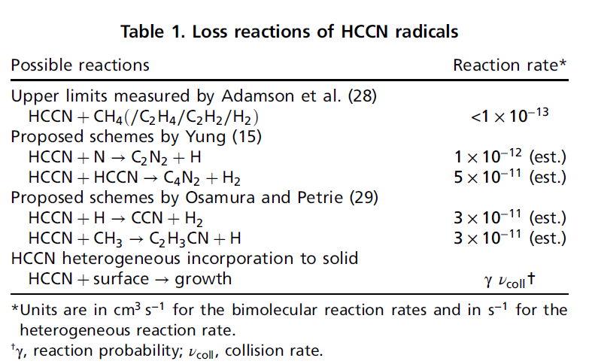
Notes:
HCCN: cyanocarbene

Slide 19
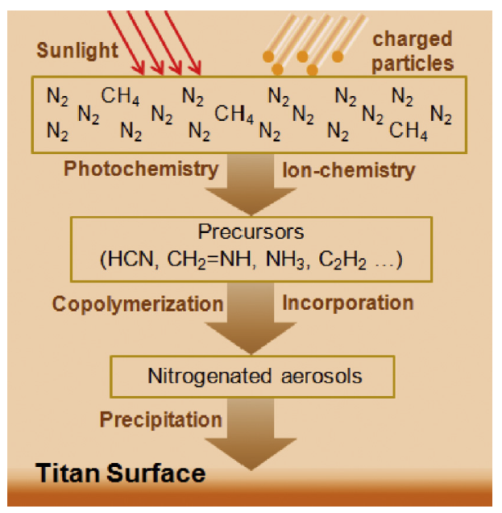
Possible Pathway for Nitrogen aerosol formation (preliminary reactions for nitrogen fixation)
He, Chao, and Mark A. Smith. “A Comprehensive NMR Structural Study of Titan Aerosol Analogs: Implications for Titan’s Atmospheric Chemistry.” Icarus, vol. 243, 2014, pp. 31–38., doi:10.1016/j.icarus.2014.09.021.

Slide 20
Conclusions
Titan’s atmosphere is rich in N₂ , which forms small nitrogenated organic aerosols via N dissociation and series of reactions (supported by studies on earth using analog to Titan aerosols--Tholin)
However, these precursors cannot continue to react because of low temperature of Titan atmosphere (just precipitate on Titan’s surface)

Slide 21
Conclusions
But! Tholin in presence of liquid water are able to hydrolyze and produce different products (even including amino acids) as a function of pH
My thoughts: when the sun becomes a red giant in the far future (or due to some other unexpected reasons), Titan’s temperature will rise and ice on the satellite will melt, leading to evolution of life

Slide 22
Reference
Imanaka, Hiroshi, and Mark A. Smith. “Formation of Nitrogenated Organic Aerosols in the Titan Upper Atmosphere.” Proceedings of the National Academy of Sciences, vol. 107, no. 28, Feb. 2010, pp. 12423–12428., doi:10.1073/pnas.0913353107.
Balucani, Nadia. “Elementary Reactions of N Atoms with Hydrocarbons: First Steps towards the Formation of Prebiotic N-Containing Molecules in Planetary Atmospheres.” Chemical Society Reviews, vol. 41, no. 16, 2012, p. 5473., doi:10.1039/c2cs35113g.
He, Chao, and Mark A. Smith. “A Comprehensive NMR Structural Study of Titan Aerosol Analogs: Implications for Titan’s Atmospheric Chemistry.” Icarus, vol. 243, 2014, pp. 31–38., doi:10.1016/j.icarus.2014.09.021.
Titan Tholins: Simulating Titan Organic Chemistry in the Cassini-Huygens Era” Morgan L. Cable, Sarah M. Hörst, Robert Hodyss, Patricia M. Beauchamp, Mark A. Smith, and Peter A. Willis Chemical Reviews 2012 112 (3), 1882-1909 DOI:10.1021/cr200221x
N. Balucani, M. Alagia, L. Cartechini, P. Casavecchia, G. G. Volpi, K. Sato, T. Takayanagi and Y. Kurosaki, J. Am. Ch. Soc., 2000, 122, 4443.
N. Balucani, F. Leonori, R. Petrucci, M. Stazi, D. Skouteris, M. Rosi and P. Casavecchia, Faraday Dis
cuss., 2010, 147, 189.
P. Casavecchia, N. Balucani, L. Cartechini, G. Capozza, A. Bergeat and G. G. Volpi, Faraday Discuss., 2001, 119, 27.
M. Rosi, S. Falcinelli1, N. Balucani, P. Casavecchia, F. Leonori and D. Skouteris, Lecture Notes in Computer Science, 2012, 7333, 331

