Slide 1
Life on Mars
By James Hedrick

Slide 2
Why do we care?
Funding- public loves aliens
  Key to increase human exploration
Help understand life on Earth

Slide 3
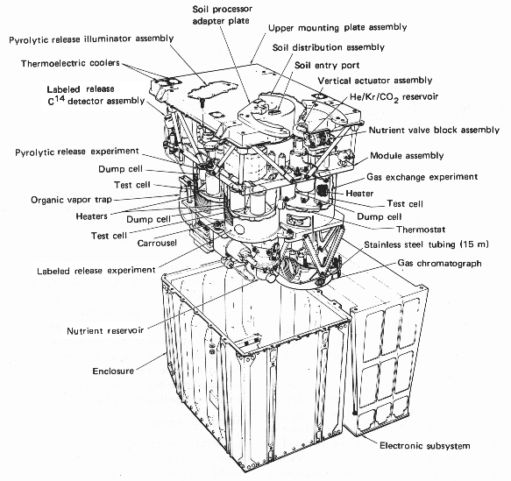
Viking Life Experiments (1976)
Gas Chromatograph — Mass Spectrometer
Gas Exchange
Labeled Release
Pyrolytic Release
Wolf Trap (cut from Mission)-used in Antarctica measured turbicity

Slide 4
Pyrolytic Release Experiment
Radioactive labeling CO2 to see carbon incorporation into organic molecules
Heated samples after incubation to look for carbon isotope
Heating a second time released similar gas compositions
Isotope C was released at 913 K both times

Slide 5
Gas Exchange
Measured gas concentrations after soil incubation of soil with nutrient rich media
The results were negative

Slide 6
Labeled Release
Studied metabolism of radioactive carbon in media solution
Looked for isotope carbon in CO2
2 sample results came back positive but a week later came back with no activity
Chemical oxidation thought as one explanation
Media could have killed cells after a little while and perchlorate oxidized the nutrients (glucose)
3 KClO₄ + C₆H₁₂O₆ → 6 H₂O + 6 CO₂ + 3 KCl

Slide 7
Gas Chromatograph — Mass Spectrometer
Soil burned to see composition
Perchlorates would have oxidized any organics in the soil
Some people believe perchlorate alone at the temperature of label release would not have oxidized all the organics
chloromethane and dichloromethane were found which could be a little perchlorate or the cleaning fluids

Slide 8
Mars Express
Seasonal changes in methane
Either biological or potentially stored in ice
The reason is unknown, also there is high noise in the reading
Notes:
Detection of Methane in the Atmosphere of Mars, Formisano, V. et al., Science, vol. 306, 2004.

Slide 9
Phoenix
Found Perchlorates in the soil
Explains gas chromatography from Viking mission
Confirms subsurface water
Maybe life is in the polar caps since it has stable amount of water

Slide 10
Curiosity
Confirms Perchlorates are widespread
Doesn’t see Methane at the current site. Nili Fossae was the site with methane plumes
Currently found organics but cannot confirm yet if there was contamination.

Slide 11
Sample Return Mission
Locations of interest
  Near the poles where subsurface ice is
  Nili Fossae Region, methane plumes
  Also in areas where soil samples showed promising results
Mass Spectrometer, best ones are too large to take to Mars
Notes:
http://www.nature.com/news/2008/081022/full/4551018a.html

Slide 12
Finding the Right Media
Data analysis of soil from Curiosity can help determine viable nutrients in a media that would be necessary to find life.

Slide 13
Microarray Cell Detection
Make arrays with many types of cell adhesion proteins
Dilute soil in media or water on top of array, allow for adhering, and gently wash away the rest
Use microscopy to detect adhesion of cells
Notes:
http://www.ncbi.nlm.nih.gov/pubmed/17127329 Mycoplasma
http://link.springer.com/article/10.1007/s00253-004-1725-0#page-1 dechloromonas
http://www.sciencedirect.com/science/article/pii/S0923250807000903
Catechol
RGD
Fibrenectin
Charge polymer layer cationic exchange column

Slide 14
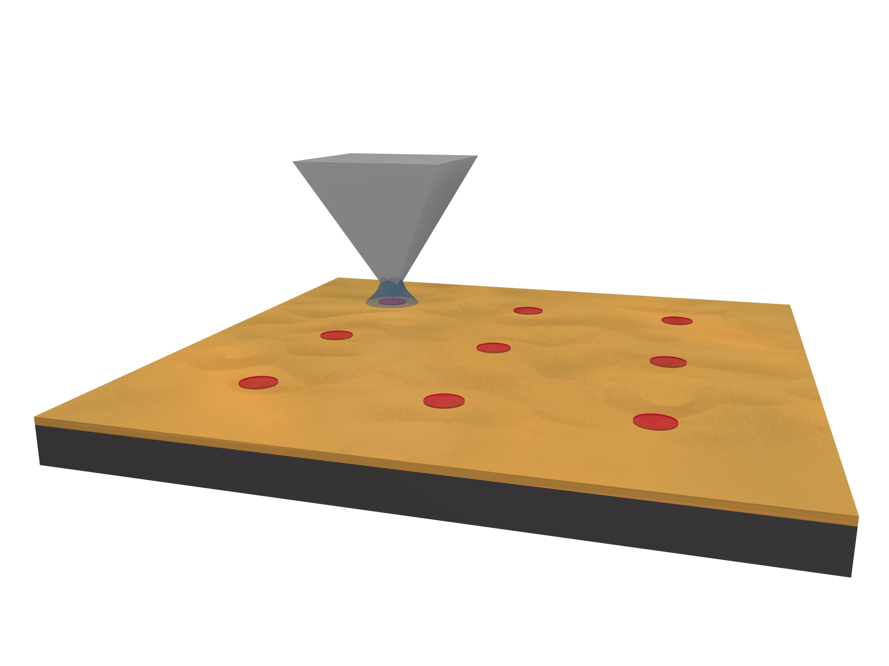
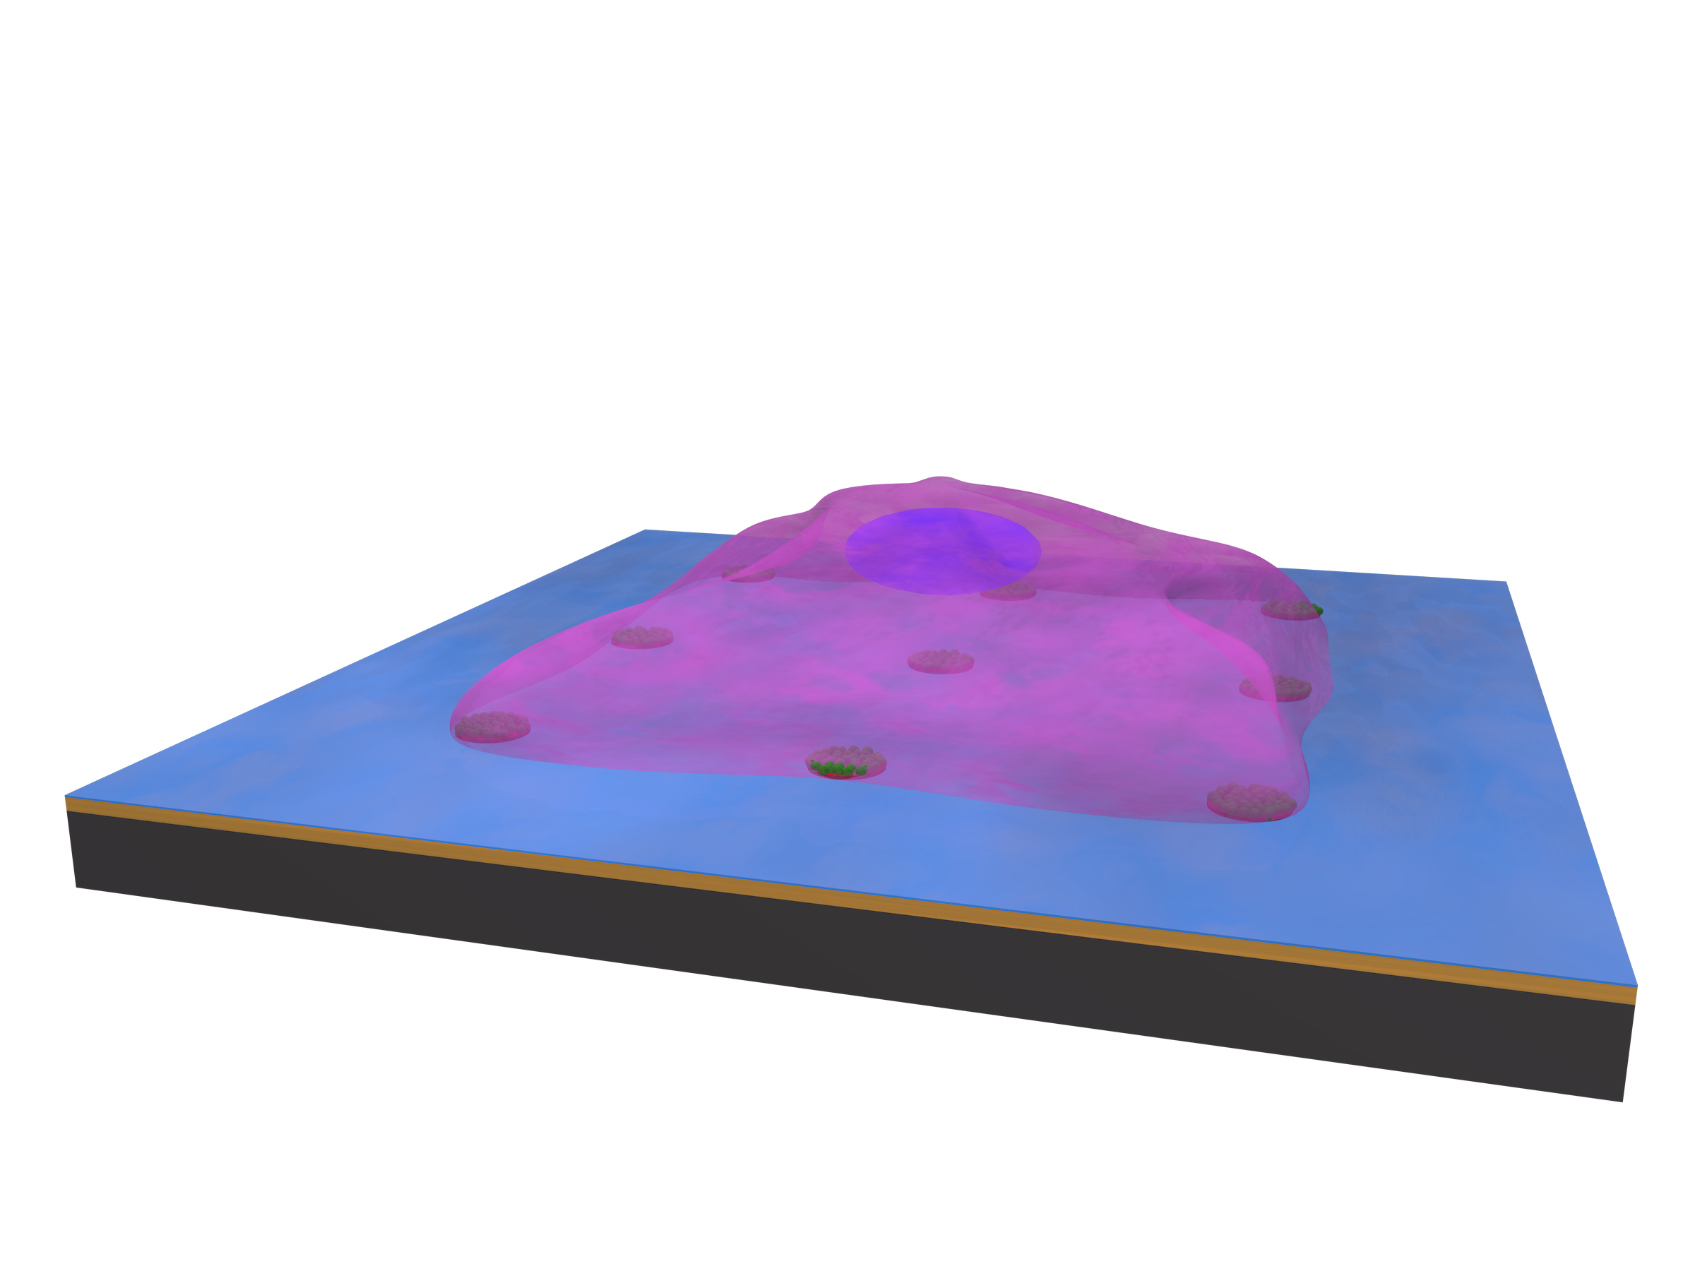
Microarray Assay
Notes:
http://www.ncbi.nlm.nih.gov/pubmed/17127329 Mycoplasma
http://link.springer.com/article/10.1007/s00253-004-1725-0#page-1 dechloromonas
http://www.sciencedirect.com/science/article/pii/S0923250807000903
Catechol
RGD
Fibrenectin
Charge polymer layer cationic exchange column

Slide 15
Microfluidic Assay
Microfluidic display to see optimal cell growth with varying nutrients in media
Only if cell detection is found in last assay
This will allow understanding of any life found on Mars

Slide 16
Human Exploration
The best way to find life is through human exploration
Since they have to return they can bring back rocks and soil from areas that experiments have yielded promising results

