Slide 1
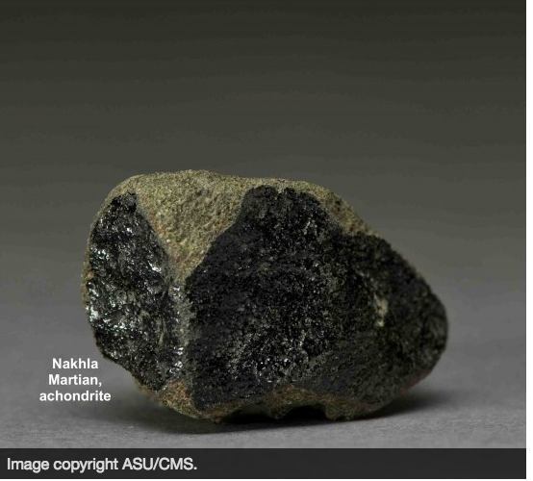
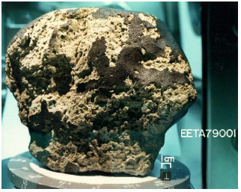
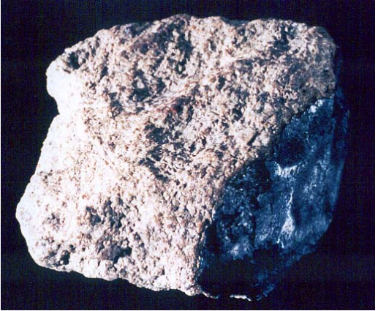
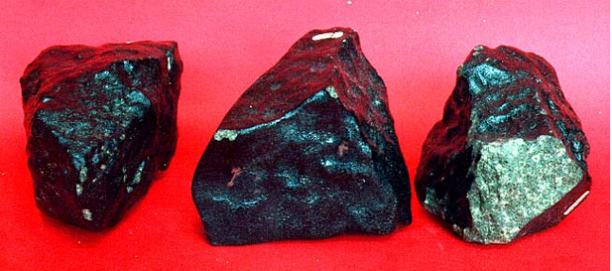
Martian Meteorites
Leah Salditch
February 27, 2017
Mars Final Project

Slide 2
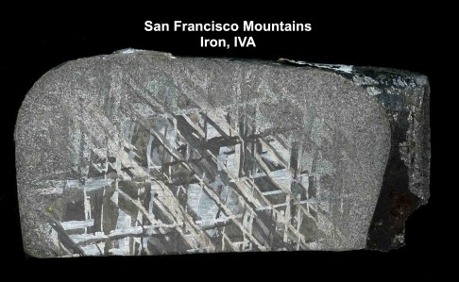
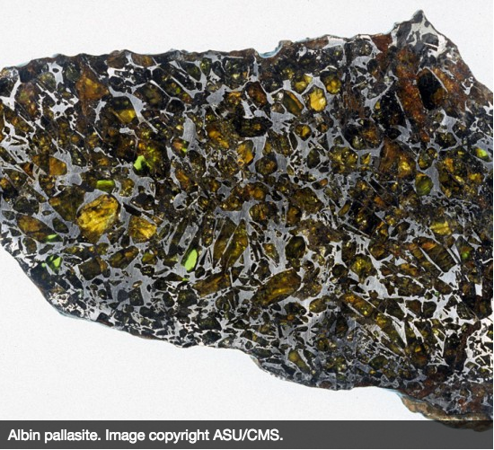
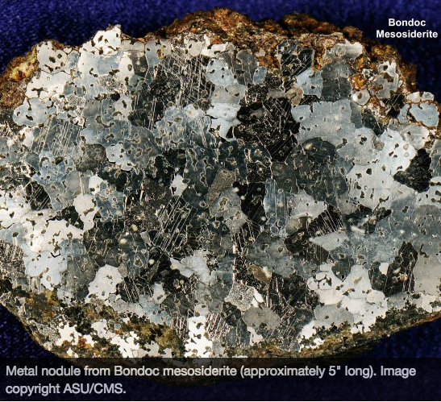
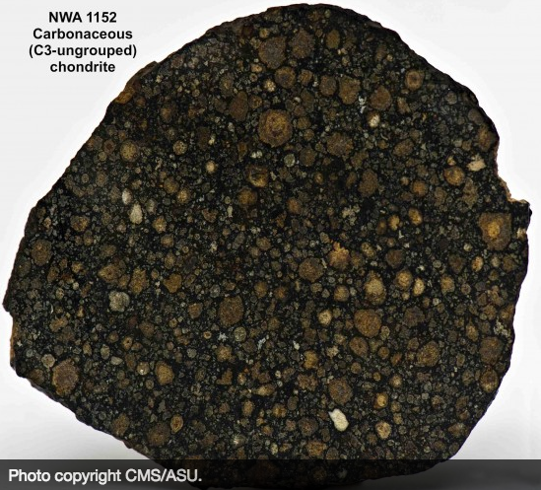
3 main types of meteorites
Iron
Stony-Iron
Pallasite
Mesosiderite
Stony
Chondrites
Achondrites
Pallasite

Slide 3
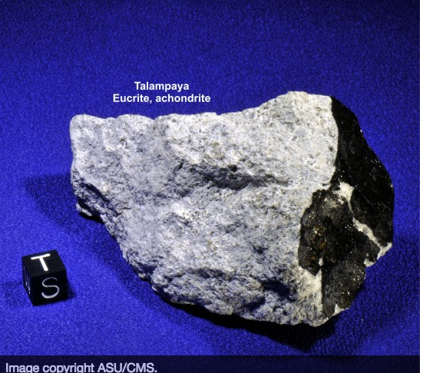
Achondrites
Basaltic
Common, comprise ~5% of all meteorite findings
Originate on differentiated planetary bodies
Asteroids (4 Vesta), planets (Mars) or moons
Materials are reformed from molten fragments created as the result of another collision

Slide 4
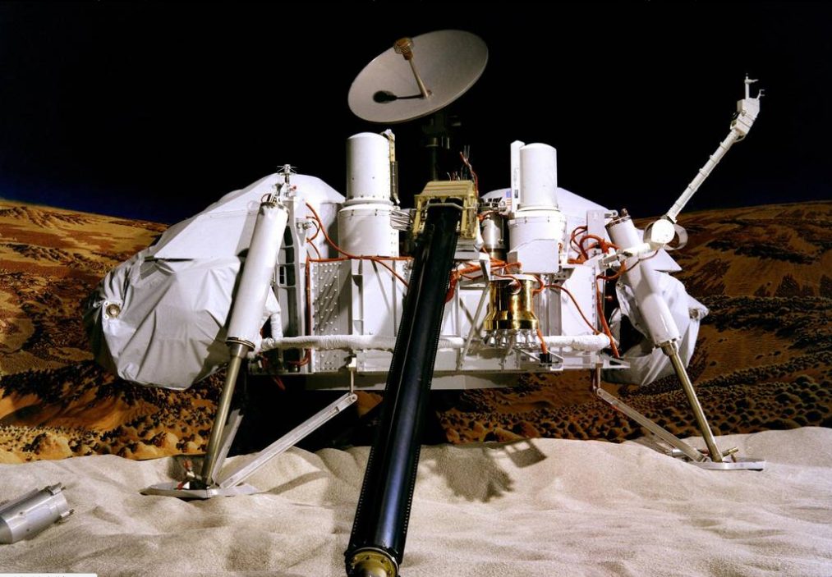
How do we know which meteorites are from Mars?

Slide 5
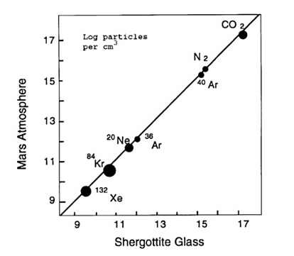
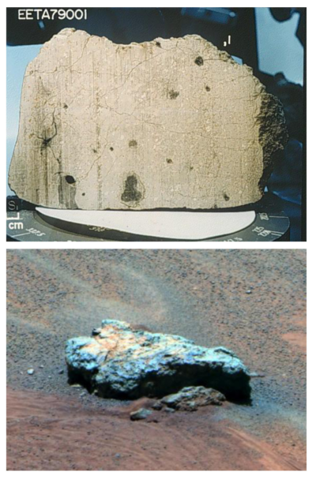
Elephant Morraine EETA79001

Slide 6
Elemental Abundances in solar system atmospheres
These ratios are distinct among gas reservoirs in the solar system
Abundance ratios near unity mean the compositions are nearly identical

Slide 7
What about the other supposedly Martian meteorites?

Slide 8
Oxygen Isotopic Compositions of Achondrites

Slide 9
Shergottites
Type sample Shergotty fell to earth in 1865 in India
Various geochemical compositions
Two main types:
Basaltic
Quickly cooled lavas
Peridotitic
Represent liquid magmas plus earlier-formed crystals which settled and cooled together slowly in large/deep magma bodies

Slide 10
Shergottites- E,D,I Classification

Slide 11
Yamato980459 Sample- Martian Mantle?

Slide 12
Nakhlites
Type sample Nakhla fell to Earth in 1911 in Egypt
Mafic: clino-pyroxene-rich cumulates that formed from basaltic igneous rocks

Slide 13
Chassigny
Fell to earth in 1815 in Chassigny, France
Ultramafic
Unique Dunite, petrologically related to Nakhlites
Contains gases that may represent Martian mantle and/or crust

Slide 14
What’s in a name?
SNC is traditional, but not very descriptive Arguments for classifying based on bulk chemical composition

Slide 15
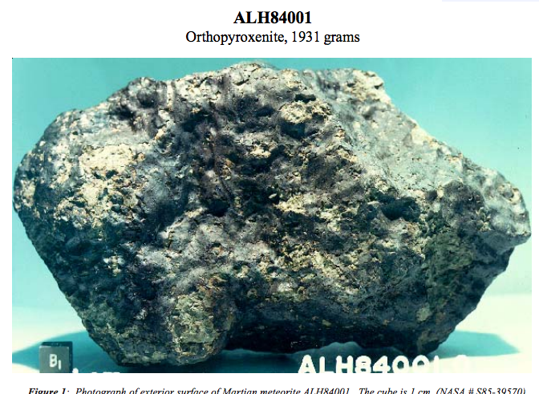
ALH84001: A unique Martian Meteorite
Oldest known Martian meteorite- (exact age estimates range from 4.51-3.9 Ga)
Not an S, N, or C
Contains carbonate deposits within fracture zones – likely precipitated from liquid water
Thought to show evidence for life on Mars
Then-President Bill Clinton held a press conference about it!

Slide 16
Is there life on Mars?

Slide 17
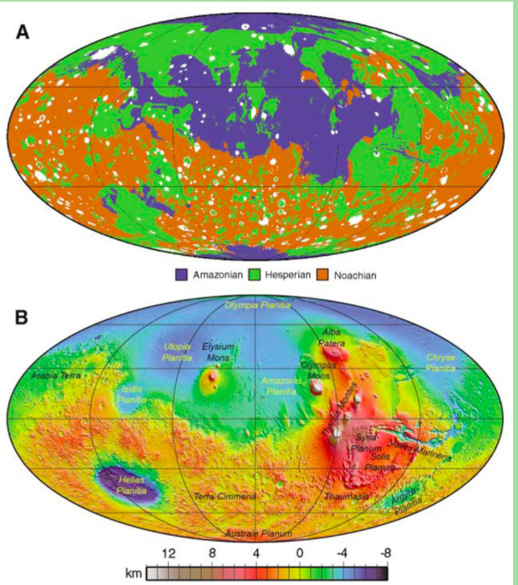
Where did they come from?
Likely small crater terrains of Amazonian to Hesperian age
Delivery of Martian rocks to earth is inherently biased toward younger, more coherent igneous rocks

Slide 18
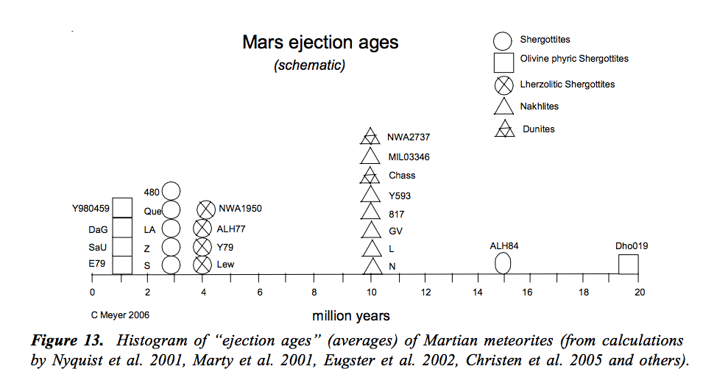
When did they leave?

Slide 19
Ejection is fairly recent, but formation ages vary widely

Slide 20
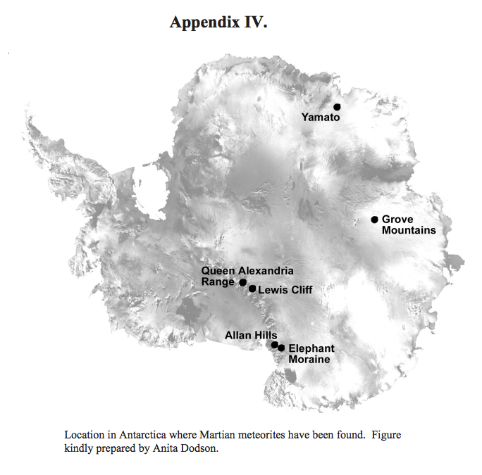
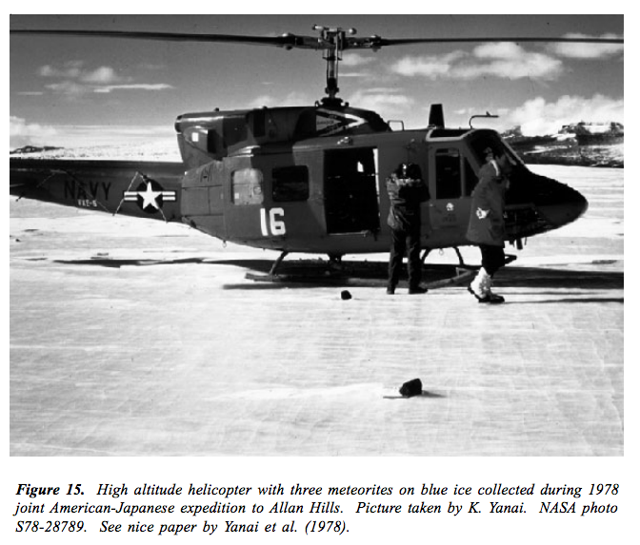
Where did they go?

Slide 22
References
1. Wong, M. H. et al. Isotopes of nitrogen on Mars: Atmospheric measurements by Curiosity’s mass spectrometer. Geophys. Res. Lett. 40, 6033–6037 (2013).
2. Jakosky, B. M. & Phillips, R. J. Mars’ volatile and climate history. Nature 412, 237–244 (2001).
3. Treiman, A. H., Gleason, J. D. & Bogard, D. D. The SNC meteorites are from Mars. Planet. Space Sci. 48, 1213– 1230 (2000).
4. McCoy, T. J., Corrigan, C. M. & Herd, C. D. K. Combining meteorites and missions to explore Mars. Proc. Natl. Acad. Sci. U. S. A. 108, 19159–64 (2011).
5. Gibson, E. K. et al. Life on Mars: evaluation of the evidence within Martian meteorites ALH84001, Nakhla, and Shergotty. Precambrian Res. 106, 15–34 (2001).
6. Bogard, D. D. & Johnson, P. Martian Gases in an Antarctic Meteorite? Source Sci. New Ser. 221, 651–654 (1983).
7. Eugster, O., Herzog, G. F., Marti, K. & Caffee, M. W. Irradiation Records, Cosmic-Ray Exposure Ages, and Transfer Times of Meteorites.
8. NASA Martian Meteorite Compendium 2012 update https://curator.jsc.nasa.gov/antmet/mmc/mmcintro2012.pdf
9. Meyer, C. NASA Martian Meteorite Compendium 2006 https://curator.jsc.nasa.gov/antmet/mmc/chap%20i.pdf
10. Tony Irving, University of Washington, Martian Meteorites, http://www.imca.cc/mars/martian-meteorites.htm
11. Arizona State University, Center for Meteorite Studies, https://meteorites.asu.edu/meteorite

