Slide 1
AJAX Mission Proposal
Taking a Look at a Trojan Asteroid

Slide 2
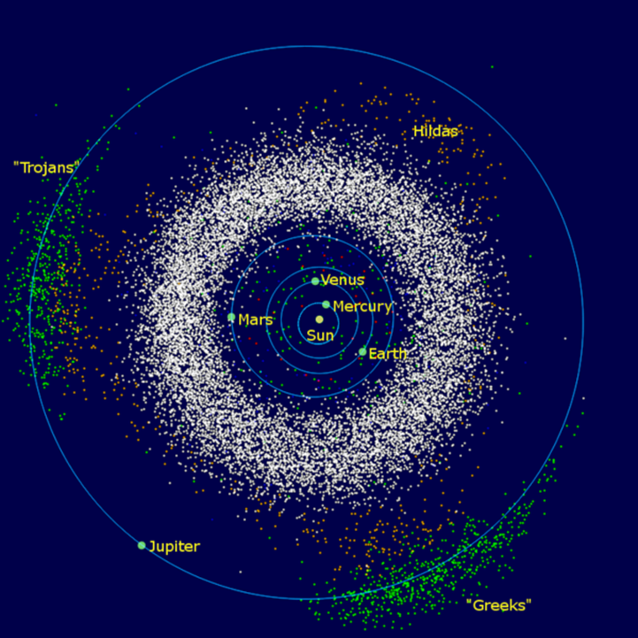
Background
•Group of asteroids that have the same orbit as Jupiter
•Two stable La Grange points 60⁰ ahead (Trojans) and 60⁰ behind (Greeks)

Slide 3
Background
They have orbits a little over 5 AU
6,704 found as of now
Possibly over 1 million over 1km diameter and average rotational period of 11.2 hours
These numbers are our best estimates
⅕ the mass of the asteroid belt

Slide 4
Background
They have orbits a little over 5 AU
6,704 found as of now
Possibly over 1 million over 1km diameter and average rotational period of 11.2 hours
These numbers are our best estimates
⅕ the mass of the asteroid belt

Slide 5
Background
Most are D-type asteroids
Low albedo (~0.04)
Reddish electromagnetic spectrum.
Composed of: organic rich silicates, carbon, anhydrous silicates and maybe ice in the center.
No probes have been sent to examine them yet

Slide 6
Background
Most are D-type asteroids
Low albedo (~0.04)
Reddish electromagnetic spectrum.
Composed of: organic rich silicates, carbon, anhydrous silicates and maybe ice in the center.
No probes have been sent to examine them yet

Slide 7
Theories of Trojan Asteroids Formation
Theory 1: Jupiter Capture
Theory 2: Kuiper Belt and Planetary Migration

Slide 8
Theories of Trojan Asteroids Formation
Theory 1: Jupiter Capture
Theory 2: Kuiper Belt and Planetary Migration

Slide 9
Theories of Trojan Asteroids Formation
Theory 1: Jupiter Capture
Theory 2: Kuiper Belt and Planetary Migration

Slide 10
What we can learn: Formation of planets
If asteroids are primordial objects, they may inform us of:
The chemical/geological processes that changed the small bodies that later made up the planets

Slide 11
What we can learn: Terrestrial Materials
The Jupiter trojans may inform us of:
How volatiles, organic compounds, C, H, and prebiotic materials were delivered to the inner solar system during the Late Heavy Bombardment (LHB)
The origin of the LMB (4.1-3.8 Ga)

Slide 12
AJAX’s Focused Payload Addresses:
2013-2022 Planetary Science Decadal Survey goals for Trojan missions:
Geological
Elemental composition
Mineralogical
Geophysical

Slide 13
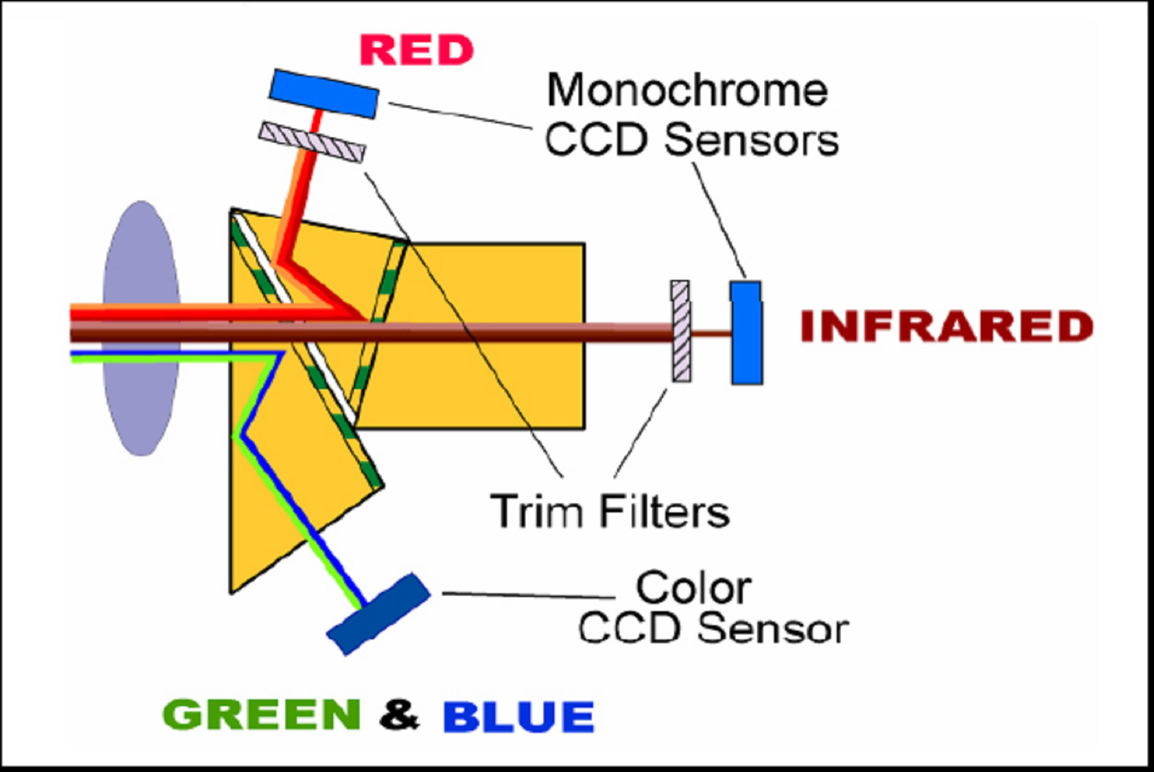
Stage 1: Initial Approach
Uses multispectral imaging at various phase angles to search for natural satellites and dust
Could be signs of frequent comet impacts
Determines shape and pole position of asteroid

Slide 14
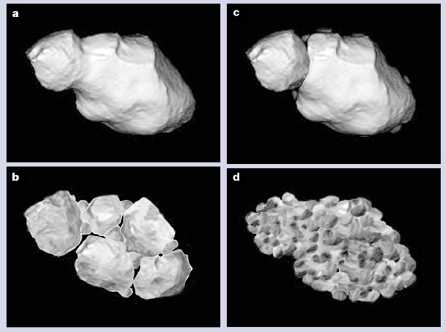
Stage 2: Descent Into Lower Orbits
Completes global mapping through high-resolution stereo and multispectral imaging
Measures gravity field to determine density and estimate interior porosity

Slide 15
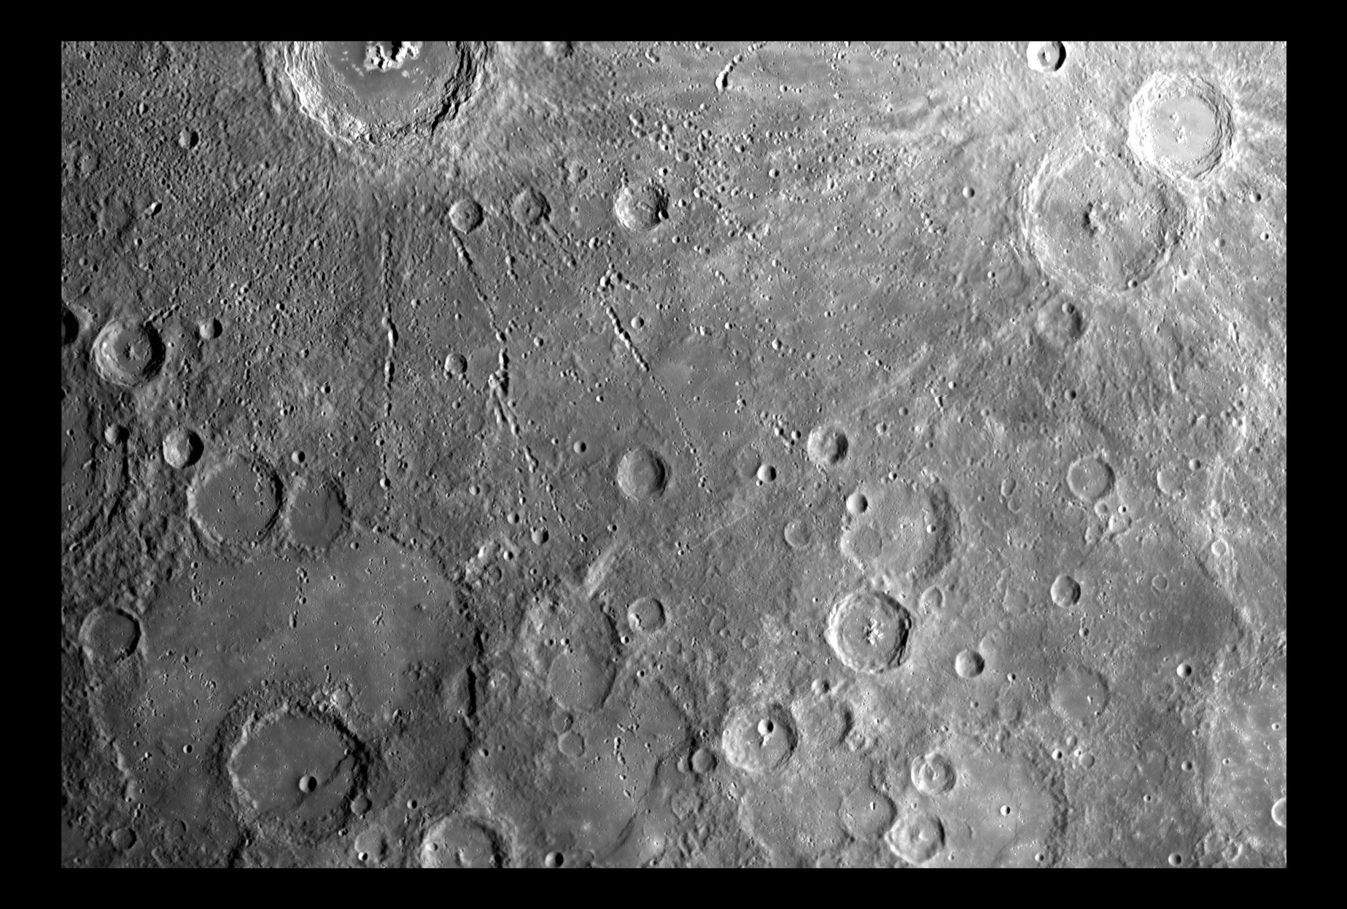
Stage 2: Descent Into Lower Orbits
Creates a high-resolution representation of the surface during a low flyover
Measures hydrogen abundance

Slide 16
Stage 3: Landed Package
Measures abundance of 20 elements including C and H concentrations
Measures physical and mechanical properties of asteroid’s regolith

Slide 17
What we learn from AJAX
From composition measurement:
Trojans’ possible role in delivering prebiotic materials to terrestrial planets
From regolith and porosity measurements:
How planetesimals form and merge into planets

Slide 18
Sustainability on Earth as a Result
Would provide knowledge of planetary origins along with:
The source of volatiles such as:
Nitrogen
Water
Carbon Dioxide
Organics on terrestrial planets

Slide 19
Sustainability as a Result
Knowing how volatiles were formed can help learn about avoiding their destruction on Earth
Could teach us about simulating the formation of these volatiles on Earth

Slide 20
Other Benefits
Learning about how we came about and why
Good return on investment
High quality pictures and data of an unexplored area

