Slide 1
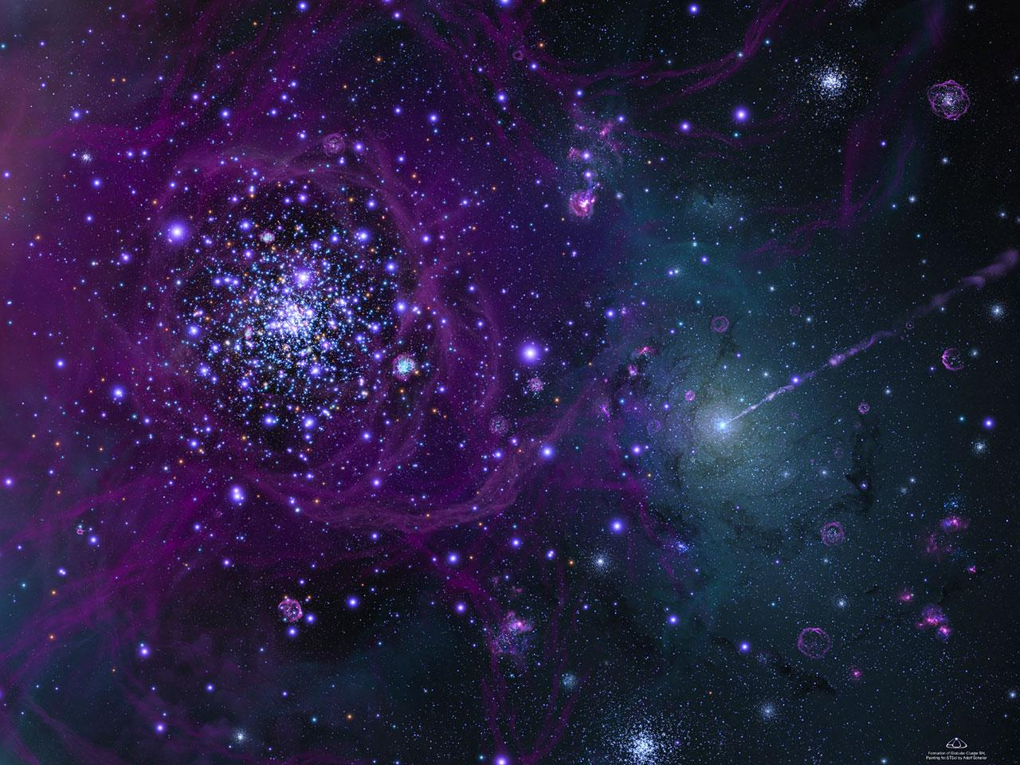
The Oort Cloud
The Edge of the Solar System

Slide 2
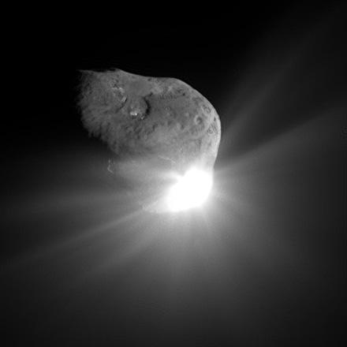
What is the Oort Cloud?
Spherical area between 5,000 and 100,000 AU from the sun (Kuiper belt ends at 55 AU)
Proxima Centauri is 270,000 AU from sun
Contains between 0.1 and 2 trillion comets
Distance between Oort Cloud Comets: 50-500 million km (0.33-3.33 AU)
Surface temp. in Oort Cloud ~5-6 K
(Kuiper belt 30-60 K)
Named after Jan Oort

Slide 3
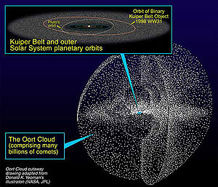

Slide 4
Oort Cloud Comets
12 comets per year leave Oort Cloud to become long-range comets
  Pushed out by large molecular clouds, passing stars, or tidal interactions with Milky Way's disc
  5 of these enter inner solar system per year
  It takes thousands of years for them to orbit the sun
Orbital velocities of Oort Cloud Comets: ~0.2 km/s
Comet composition: equal parts non-volatile solids and volatile ices

Slide 5
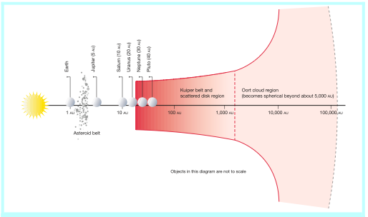

Slide 6
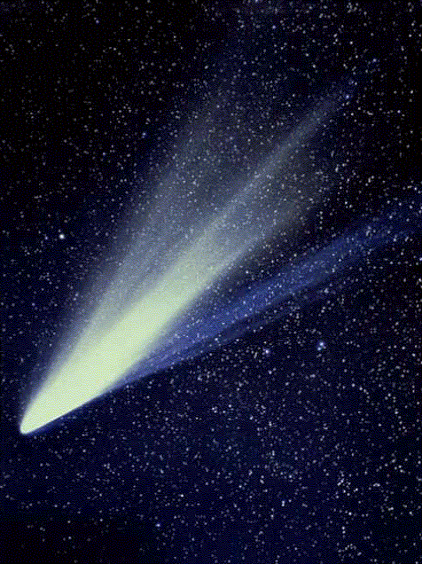
Origin of Oort Cloud Comets
Could have formed near gas giants and slowly migrated outward
Others believe 30% came
from Kuiper Belt
“It is likely that over 90%
of the observed Oort
Cloud Comets have an
extrasolar origin” - H. Levison
Comet West

Slide 7
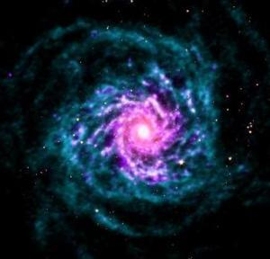
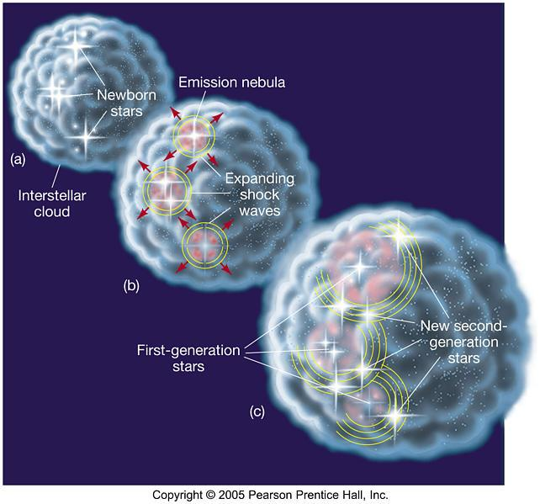
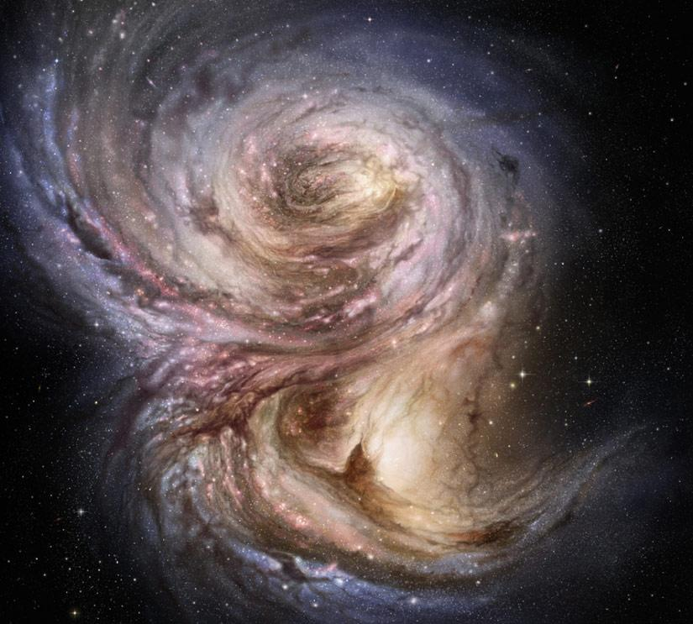
Binary Star Systems
Primordial star cloud splits into two distinct parts with different gravitational areas
Comprise 46% of star systems
55% of star systems have at least two stars
Notes:
Theory about the oort cloud having a brown dwarf inside it

Slide 8
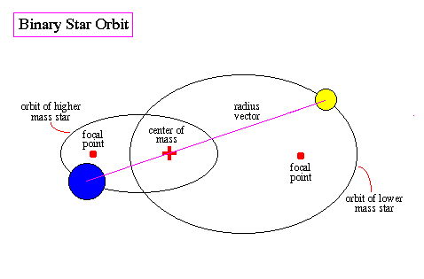
Binary Star System

Slide 9
Brown Dwarf Binary Systems
Examples
  LHS 2397a
    2.96 AU apart, brown dwarf as companion star
  G196-3
    300 AU apart, brown dwarf companion size of Jupiter
      Likelihood of brown dwarf solar companions increases as star distance increases

Slide 10
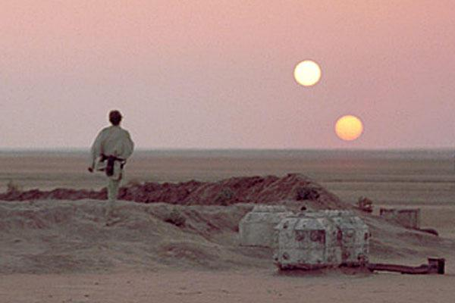
Is Our Sun a Binary Star?
System found with materials for terrestrial planets
  Like Earth...

Slide 11
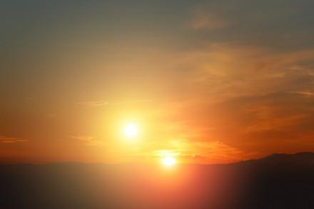
Unrealistic!

Slide 12
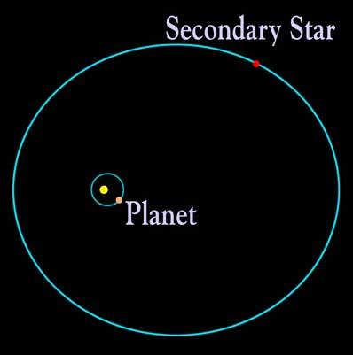
Realistic!

Slide 13
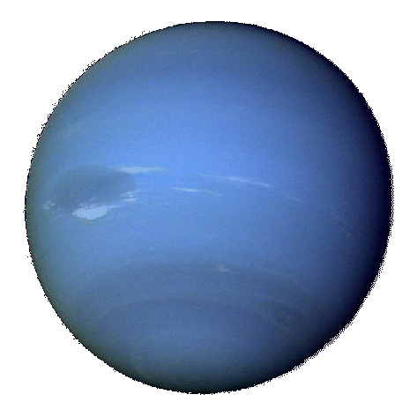
Does Our Solar Companion Exist?
Efforts using gravitational pull have been unsuccessful
  Last success was Neptune in 1846
  Use data from comet orbits
    Only 82 well studied comets
Conflicting evidence over Jovian Body location
  inside or next to oort cloud?

Slide 14
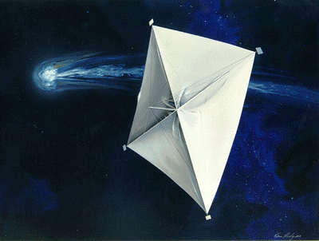
Applicable Technologies
Infrared Imaging
  Wide-Field IR Survey Explorer (WISE, 2009)
  IR Astronomical Satellite (IRAS, 1983)
Astrometric Microlensing
Orbital Trajectory Anomalies
Solar Sails
Notes:
WISE surveys entire sky in 6 months, will be able to identify Jupiter-sized bodies at distances of about 10^4 A

Slide 15
Past and Future Comet Missions
Halley's Comet Revolution, 1986
  Five international satellites
Rosetta (ESA), 2004-Present
Stardust, 2004-2011
Deep Impact, 2005-2011
  High Resolution and Medium Resolution Imagers (HRI and MRI)
Notes:
ICE flew through the tail of Giacobini-Zinner
Rosetta orbits 67P for 17 months; heat is a big concern; will enter orbit and land a probe on it in 2014

Slide 16
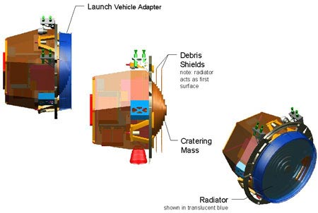
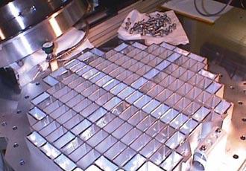
ROCCET:
Researching an Oort Cloud Comet: Examination and Tracking
Tracking device
Impactor
Aerogel dust collectors and analyzers
Sample return
Mass spectrometer
HRI and MRI
Solar panel
Top: Deep Impact's impactor
Bottom: Stardust aerogel dust collectors
Notes:
Aerogel Dust Collector
1000 cm^2 for interstellar dust and 1000 cm^2 for cometary dust
Dust sticks; no other mechanism but exposure
Cometary and Interstellar Dust Analyzer
Immediate analysis of samples
Has flown on multiple missions (Giotto, two Vega)
Mass spectrometer

Slide 17
ROCCET's Mission
After ROCCET has been built, we will find an Oort Cloud Comet that is approaching the sun
Launch ROCCET so it lands on comet before it reaches the sun
  Take sample and return it to Earth before comet gets too close to sun
ROCCET will stay on comet while it circles sun and track its path as it continues to the outer solar system

Slide 18
Cost of Mission
Deep Impact: $267 million
  NASA considers this a low cost mission
STARDust: $300 million
NASA's yearly budget: $18.4 billion
Mission estimate: $325 million
  1.6% of NASA's yearly budget
In conclusion, we will be gaining lots of scientific information for relatively little cost!

